Slide 1
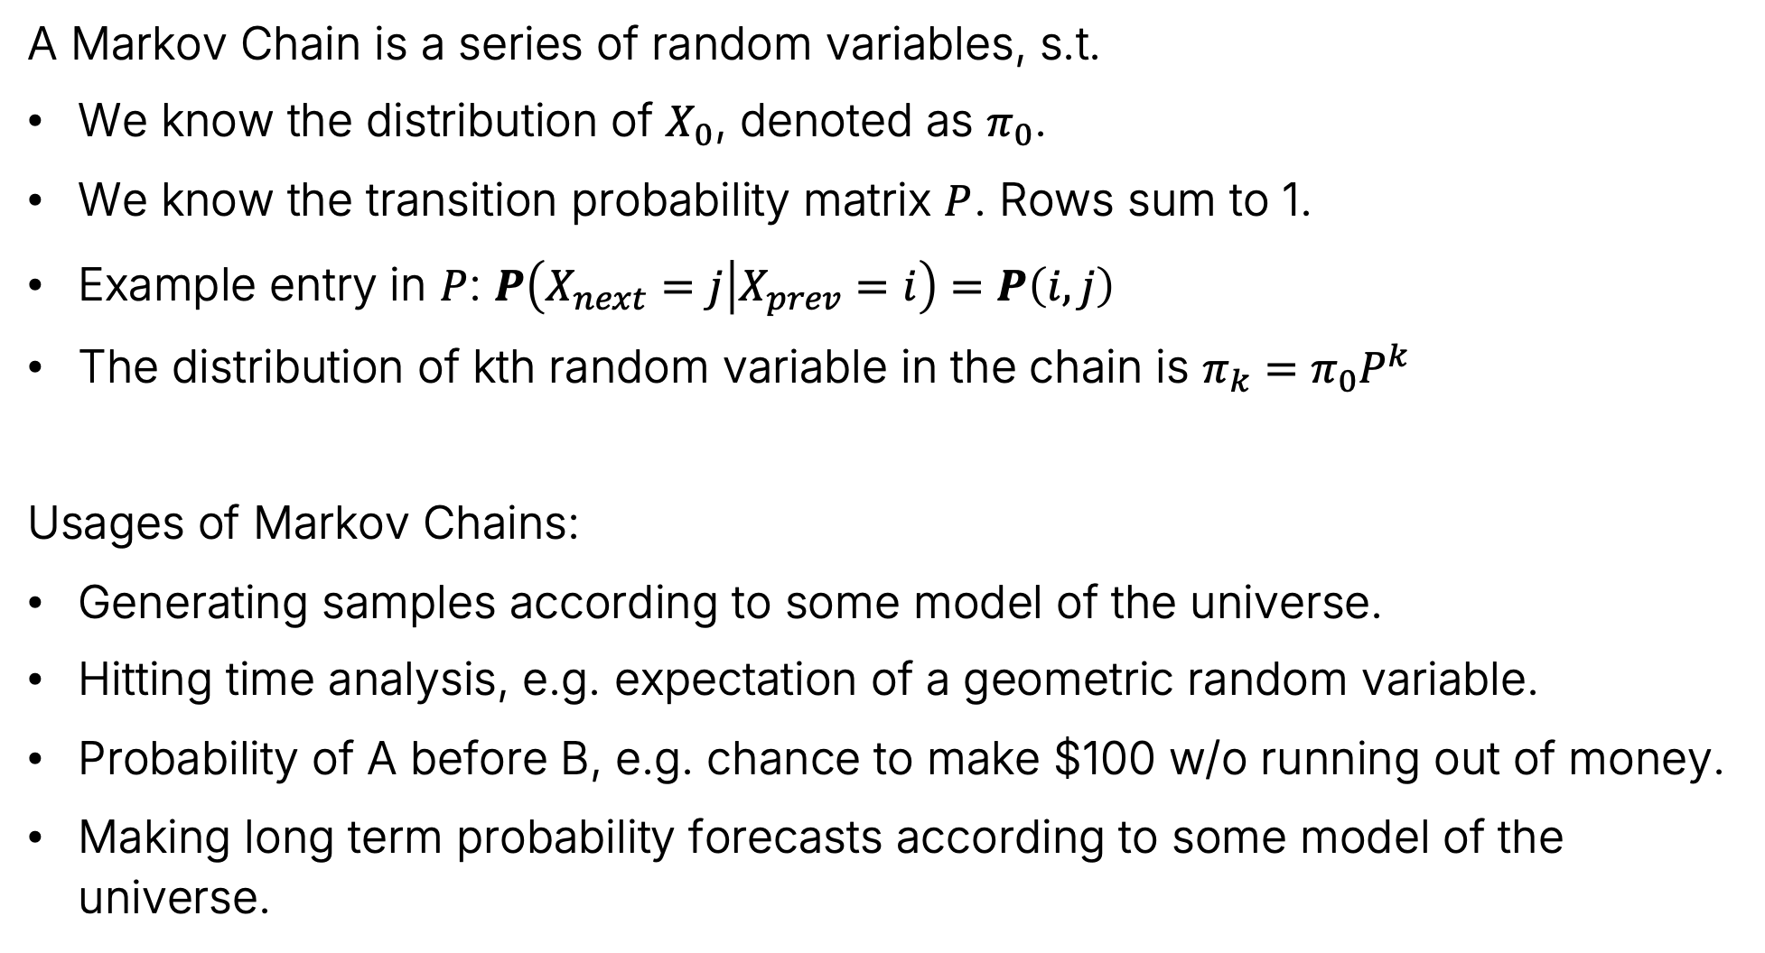
Previous Lecture Summary
A Markov Chain is a series of random variables, s.t.
We know the distribution of $X_{0}$, denoted as $π_{0}$.
We know the transition probability matrix $P$. Rows sum to 1.
Example entry in $P$: $P\left(X_{next}=j | X_{prev}=i\right)=P\left(i,j\right)$
The distribution of kth random variable in the chain is $π_{k}=π_{0}P^{k}$
Usages of Markov Chains:
Generating samples according to some model of the universe.
Hitting time analysis, e.g. expectation of a geometric random variable.
Probability of A before B, e.g. chance to make $100 w/o running out of money.
Making long term probability forecasts according to some model of the universe.

Slide 2
The Stationary Distribution (Continued)
The Stationary Distribution (Continued)
Irreducibility and Periodicity
Generating Text with a Markov Chain
Word Level Markov Chains
Brief Look at Large Language Models
Embeddings and Tokenization
Modifying Token Meaning with Vector Operations
Generating Next Token Using Enriched Tokens
Reflections on CS70
Lecture 26, CS70 Fall 2025

Slide 3
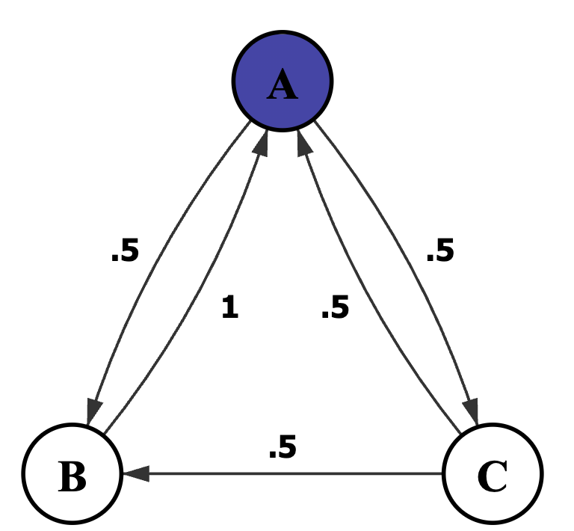
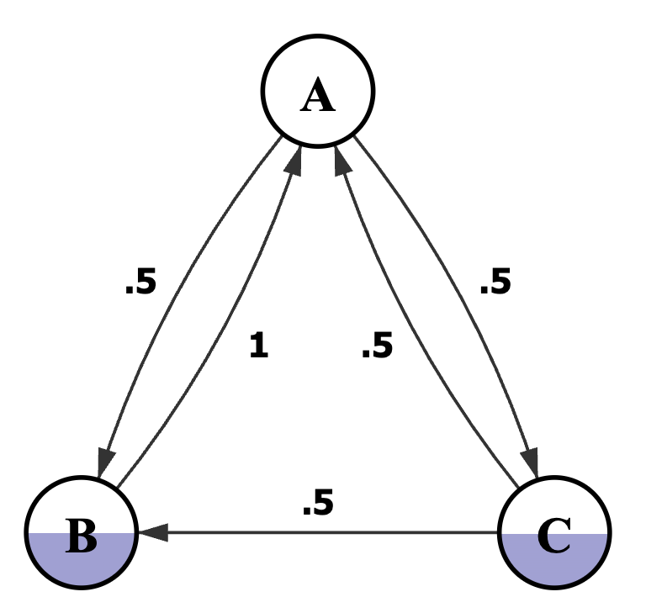
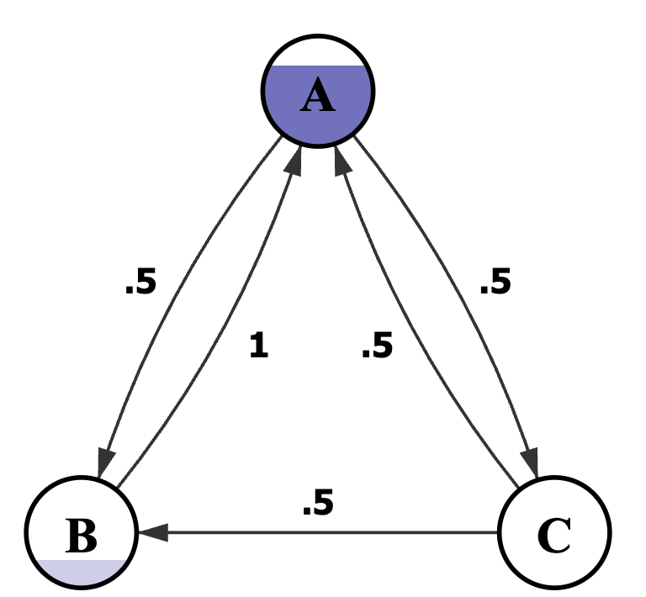
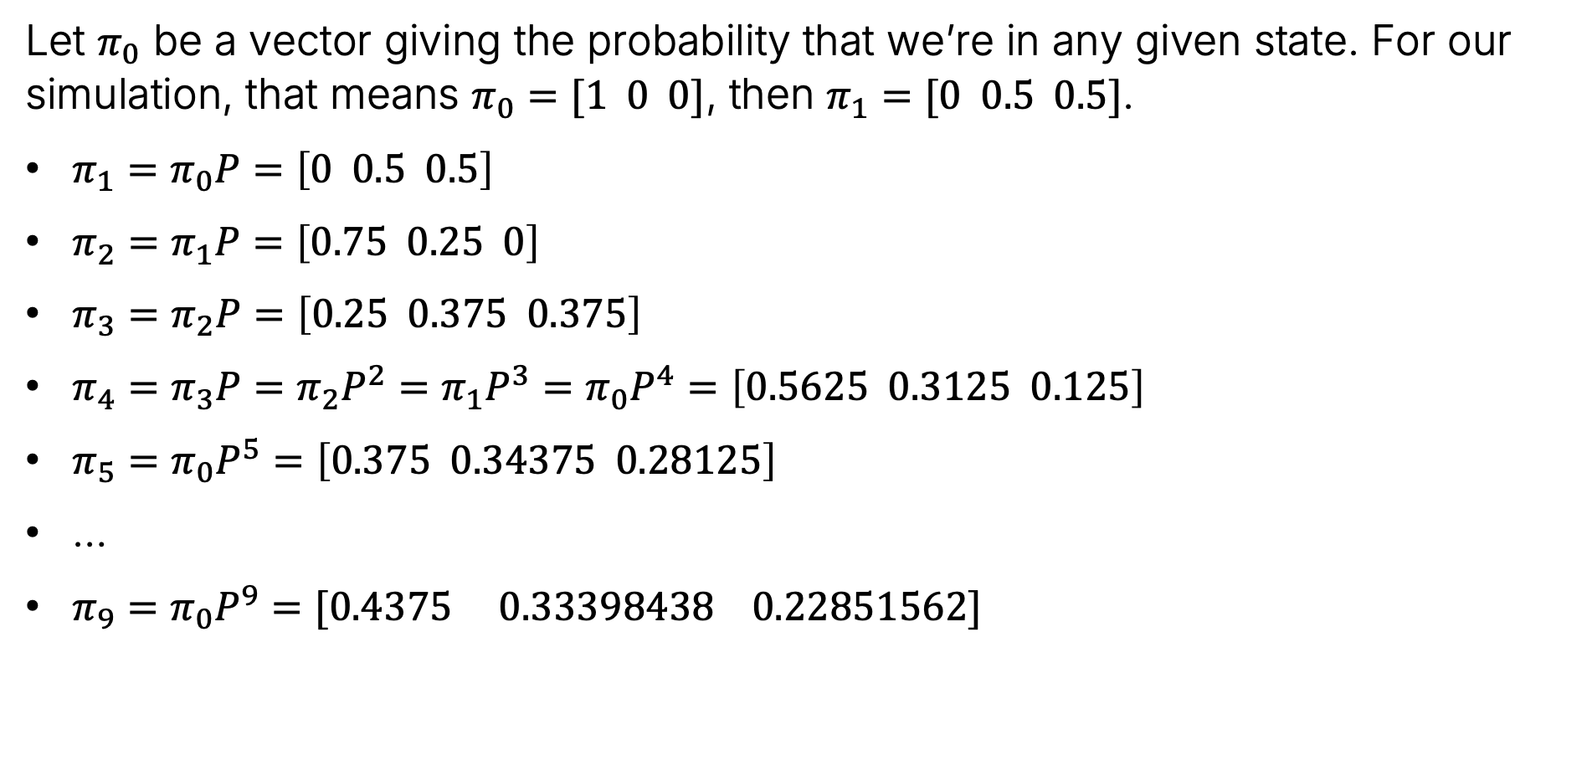
Last Time: Long Term Behavior of Three State Markov Chain using Linear Algebra
Let $π_{0}$ be a vector giving the probability that we’re in any given state. For our simulation, that means $π_{0}=[1 0 0]$, then $π_{1}=[0 0.5 0.5]$.
$π_{1}=π_{0}P=\left[0 0.5 0.5\right]$
$π_{2}=π_{1}P=\left[0.75 0.25 0\right]$
$π_{3}=π_{2}P=\left[0.25 0.375 0.375\right]$
$π_{4}=π_{3}P=π_{2}P^{2}=π_{1}P^{3}=π_{0}P^{4}=\left[0.5625 0.3125 0.125\right]$
$π_{5}=π_{0}P^{5}=\left[0.375 0.34375 0.28125\right]$
…
$π_{9}=π_{0}P^{9}=[0.4375 0.33398438 0.22851562]$

Slide 4
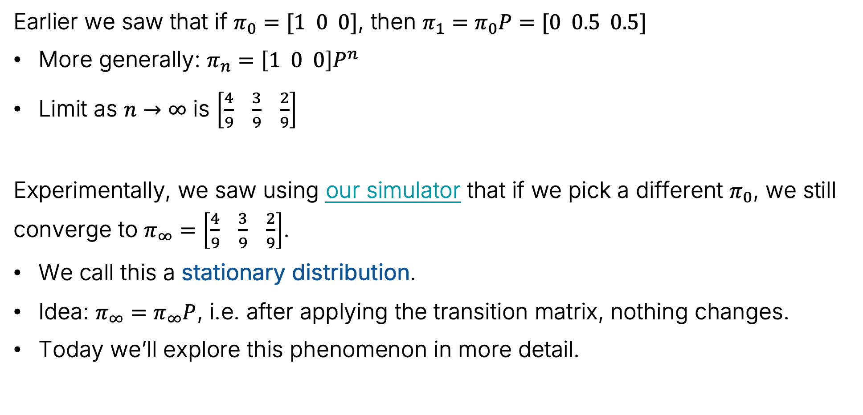
Last Time: Long Term Behavior of Three State Markov Chain using Linear Algebra
Earlier we saw that if $π_{0}=[1 0 0]$, then $π_{1}=π_{0}P=[0 0.5 0.5]$
More generally: $π_{n}=\left[1 0 0\right]P^{n}$
Limit as $n→∞$ is $\left[\frac{4}{9} \frac{3}{9} \frac{2}{9}\right]$
Experimentally, we saw using our simulator that if we pick a different $π_{0}$, we still converge to $π_{∞}=$ $\left[\frac{4}{9} \frac{3}{9} \frac{2}{9}\right]$.
We call this a stationary distribution.
Idea: $π_{∞}=π_{∞}P$, i.e. after applying the transition matrix, nothing changes.
Today we’ll explore this phenomenon in more detail.

Slide 5
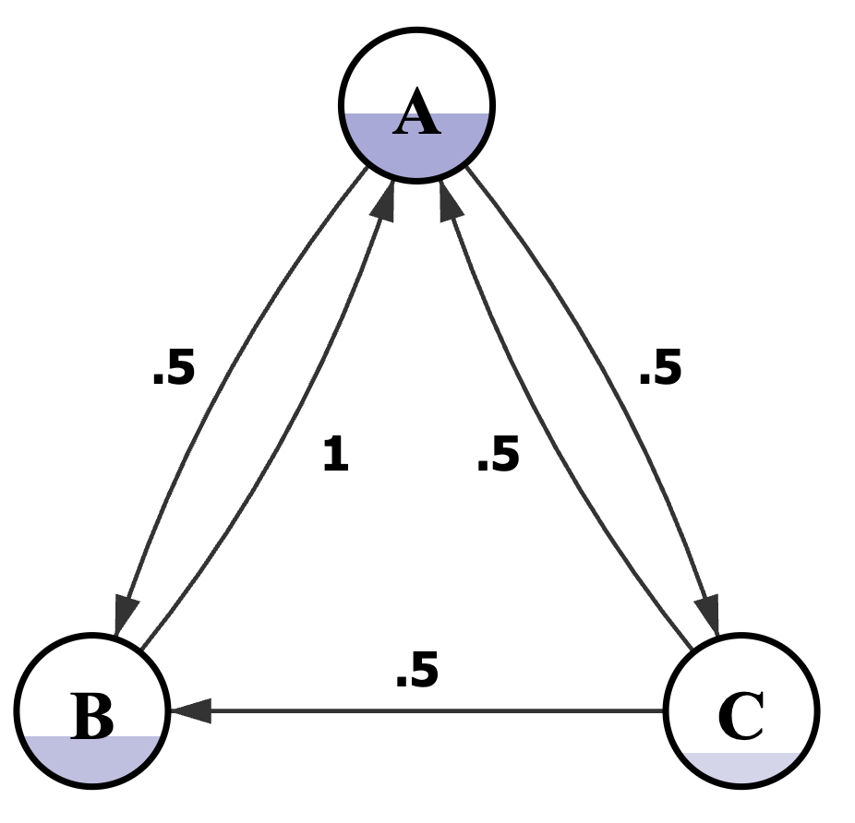
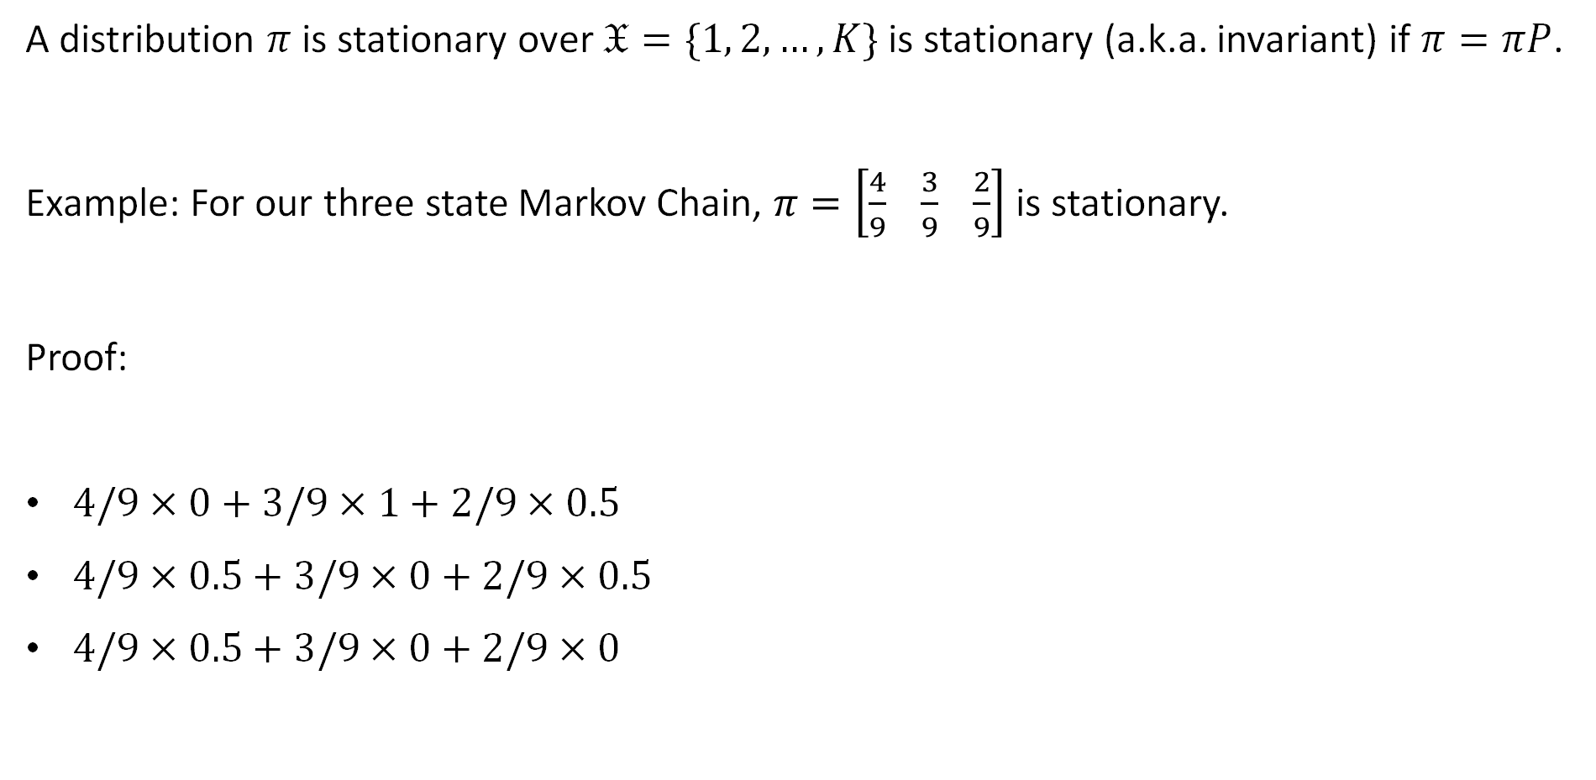
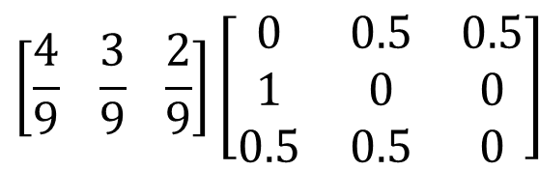
Example 1: Stationary Distribution
A distribution $π$ is stationary over $𝔛=\{1, 2, …, K\}$ is stationary (a.k.a. invariant) if $π=πP$.
Example: For our three state Markov Chain, $π=\left[\frac{4}{9} \frac{3}{9} \frac{2}{9}\right]$ is stationary.
Proof:
$4/9×0+3/9×1+2/9×0.5$
$4/9×0.5+3/9×0+2/9×0.5$
$4/9×0.5+3/9×0+2/9×0$
$$\left[\frac{4}{9} \frac{3}{9} \frac{2}{9}\right]\left[\begin{matrix}0 & 0.5 & 0.5 \\ 1 & 0 & 0 \\ 0.5 & 0.5 & 0\end{matrix}\right]$$
$=$ $4/9$
$=$ $3/9$
$=$ $2/9$

Slide 6
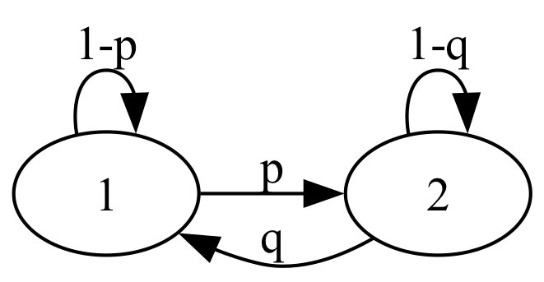

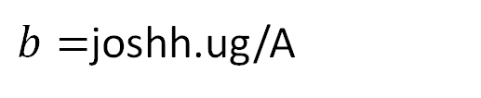
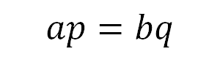
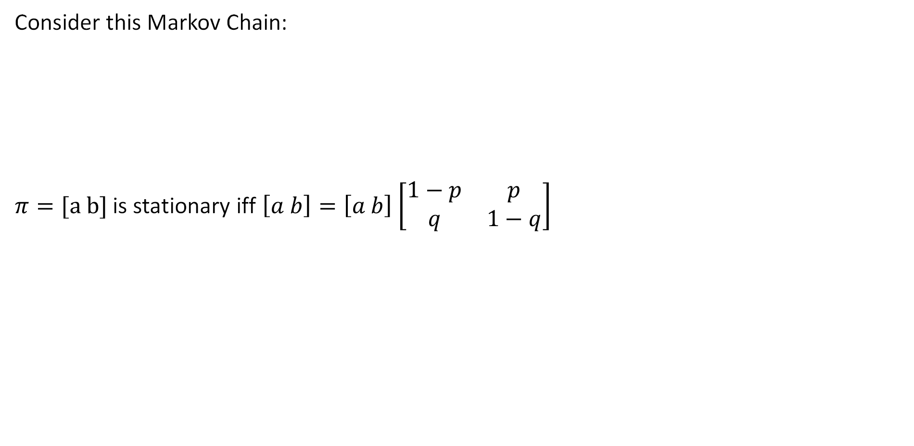

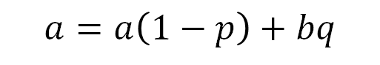
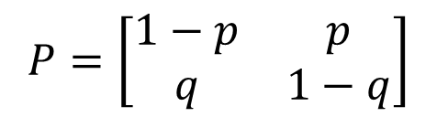
Example 2: Stationary Distribution
Consider this Markov Chain:
$π=[a b]$ is stationary iff $\left[a b\right]=\left[a b\right]$ $\left[\begin{matrix}1−p & p \\ q & 1−q\end{matrix}\right]$
$$P=\left[\begin{matrix}1−p & p \\ q & 1−q\end{matrix}\right]$$
$$a=a\left(1−p\right)+bq$$
$$⟺$$
$$ap=bq$$
$b=$joshh.ug/A

Slide 7

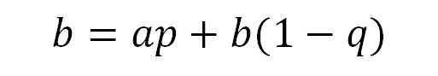
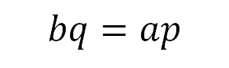

Example 2: Stationary Distribution
Consider this Markov Chain:
$π=[a b]$ is stationary iff $\left[a b\right]=\left[a b\right]$ $\left[\begin{matrix}1−p & p \\ q & 1−q\end{matrix}\right]$
$$P=\left[\begin{matrix}1−p & p \\ q & 1−q\end{matrix}\right]$$
$$a=a\left(1−p\right)+bq$$
$$⟺$$
$$ap=bq$$
$$b=ap+b(1−q)$$
$$⟺$$
$$bq=ap$$
What we do next? We have two equations and two unknowns, but the equations are redundant: joshh.ug/B

Slide 8
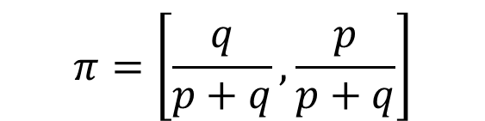
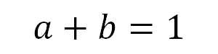
Example 2: Stationary Distribution
Consider this Markov Chain:
$π=[a b]$ is stationary iff $\left[a b\right]=\left[a b\right]$ $\left[\begin{matrix}1−p & p \\ q & 1−q\end{matrix}\right]$
$$P=\left[\begin{matrix}1−p & p \\ q & 1−q\end{matrix}\right]$$
$$a=a\left(1−p\right)+bq$$
$$⟺$$
$$ap=bq$$
$$b=ap+b(1−q)$$
$$⟺$$
$$bq=ap$$
We also know:
$$a+b=1$$
$$π=\left[\frac{q}{p+q},\frac{p}{p+q}\right]$$

Slide 9
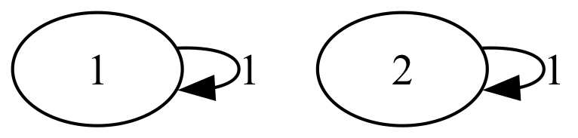

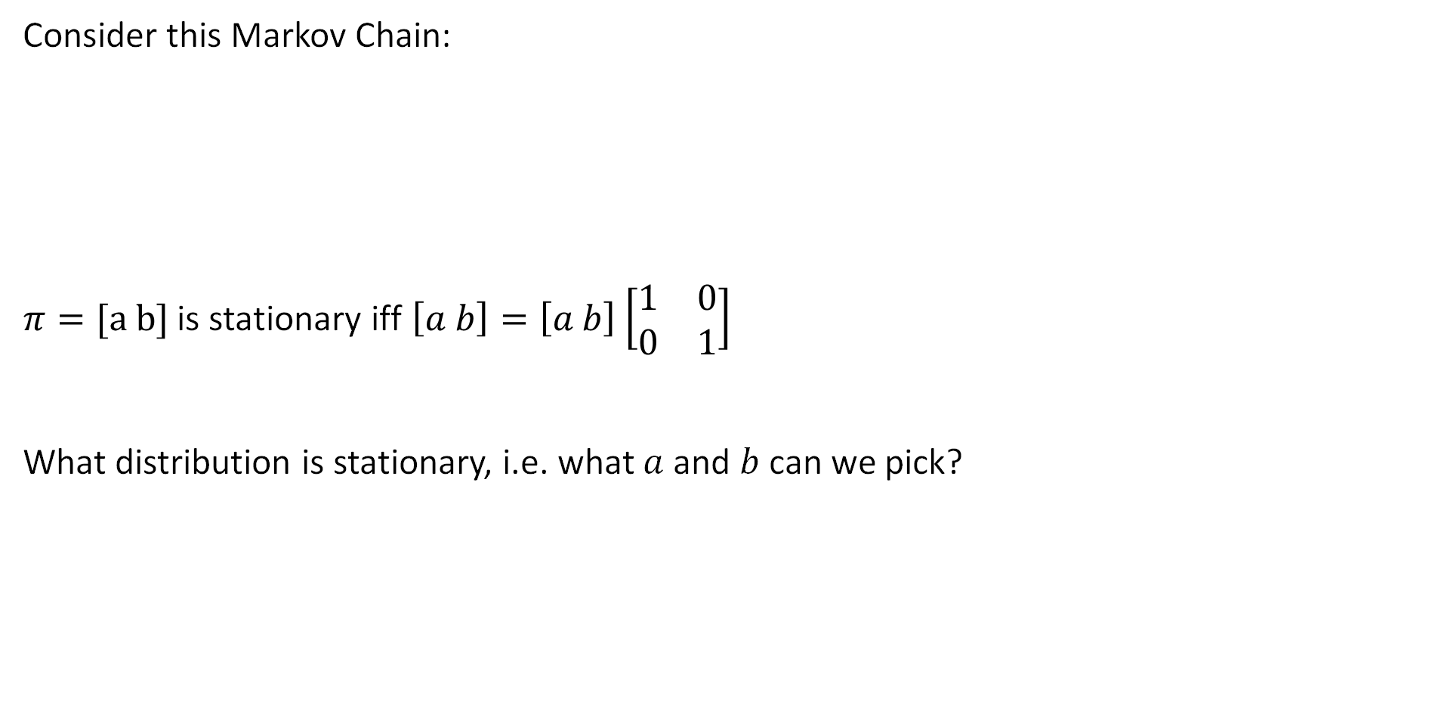
Example 2: Stationary Distribution
Consider this Markov Chain:
$π=[a b]$ is stationary iff $\left[a b\right]=\left[a b\right]$ $\left[\begin{matrix}1 & 0 \\ 0 & 1\end{matrix}\right]$
What distribution is stationary, i.e. what $a$and $b$ can we pick?
$$P=\left[\begin{matrix}1 & 0 \\ 0 & 1\end{matrix}\right]$$

Slide 10
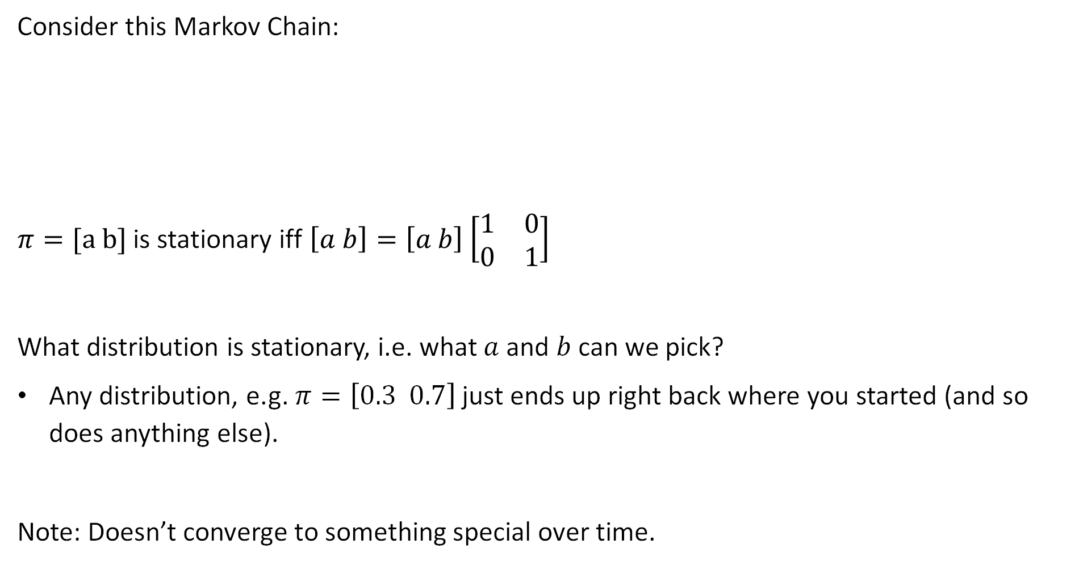
Example 2: Stationary Distribution
Consider this Markov Chain:
$π=[a b]$ is stationary iff $\left[a b\right]=\left[a b\right]$ $\left[\begin{matrix}1 & 0 \\ 0 & 1\end{matrix}\right]$
What distribution is stationary, i.e. what $a$and $b$ can we pick?
Any distribution, e.g. $π=\left[0.3 0.7\right]$ just ends up right back where you started (and so does anything else).
Note: Doesn’t converge to something special over time.
$$P=\left[\begin{matrix}1 & 0 \\ 0 & 1\end{matrix}\right]$$

Slide 11
Irreducibility and Periodicity
The Stationary Distribution (Continued)
Irreducibility and Periodicity
Generating Text with a Markov Chain
Word Level Markov Chains
Brief Look at Large Language Models
Embeddings and Tokenization
Modifying Token Meaning with Vector Operations
Generating Next Token Using Enriched Tokens
Reflections on CS70
Lecture 26, CS70 Fall 2025

Slide 12
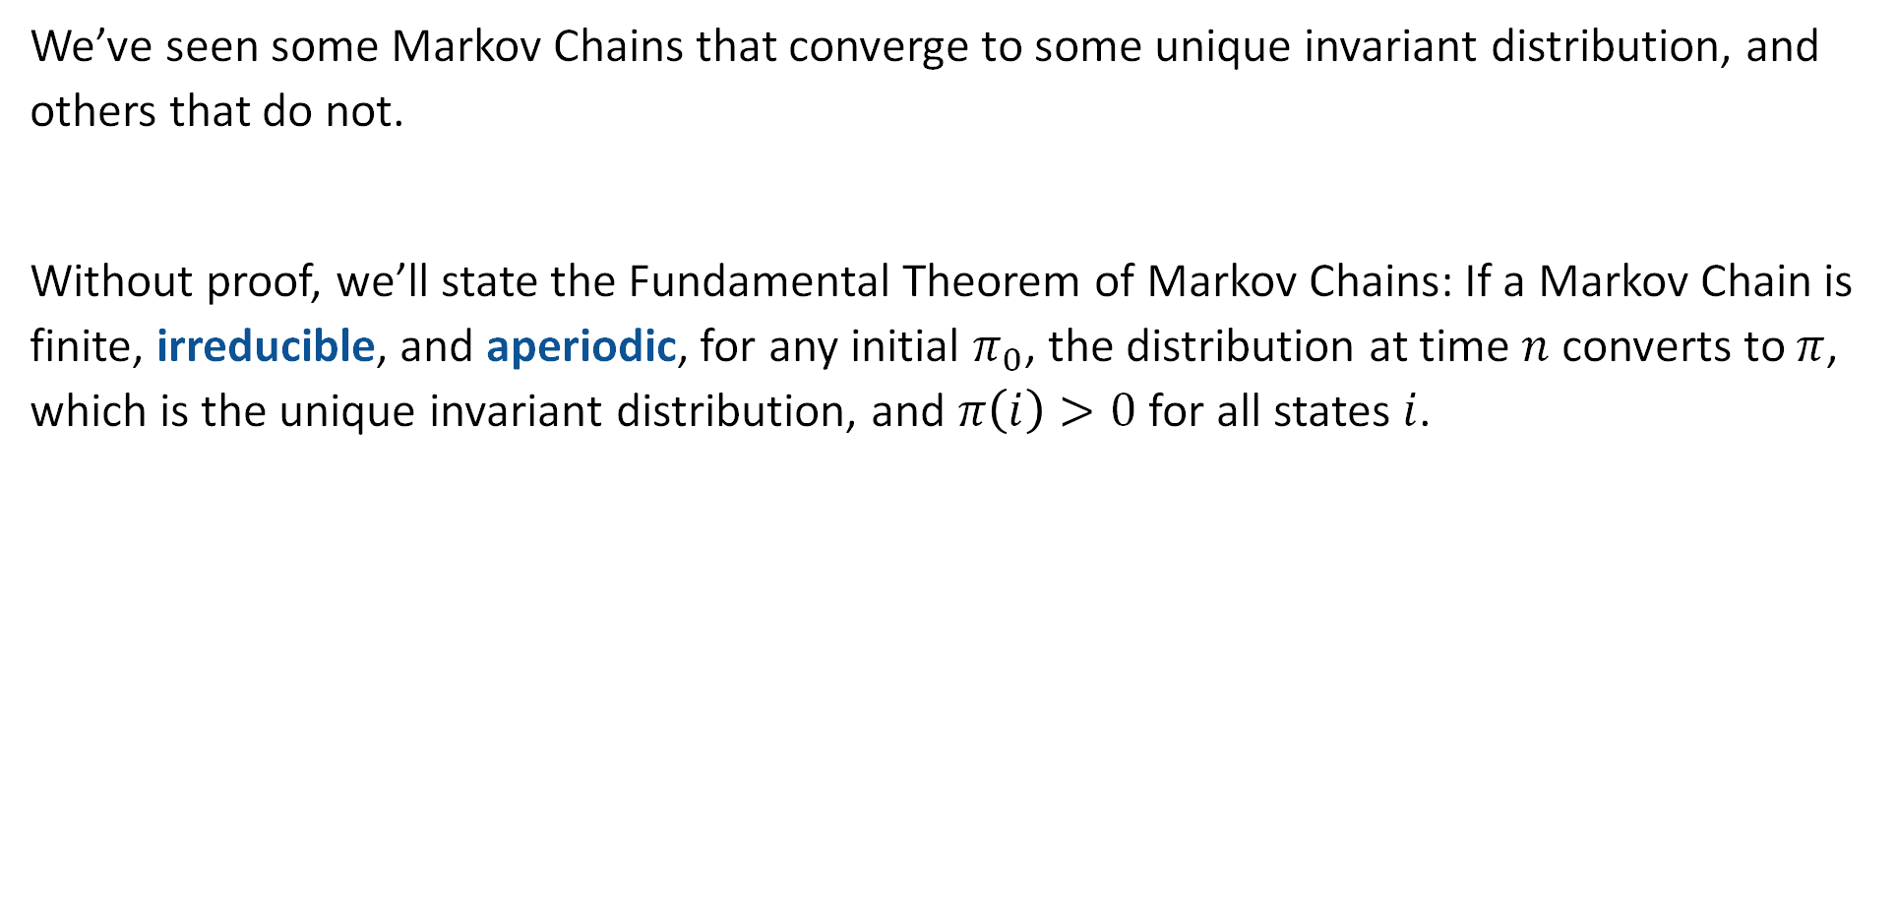
The Fundamental Theorem of Markov Chains
We’ve seen some Markov Chains that converge to some unique invariant distribution, and others that do not.
Without proof, we’ll state the Fundamental Theorem of Markov Chains: If a Markov Chain is finite, irreducible, and aperiodic, for any initial $π_{0}$, the distribution at time $n$ converts to $π$, which is the unique invariant distribution, and $π\left(i\right)>0$ for all states $i$.

Slide 13
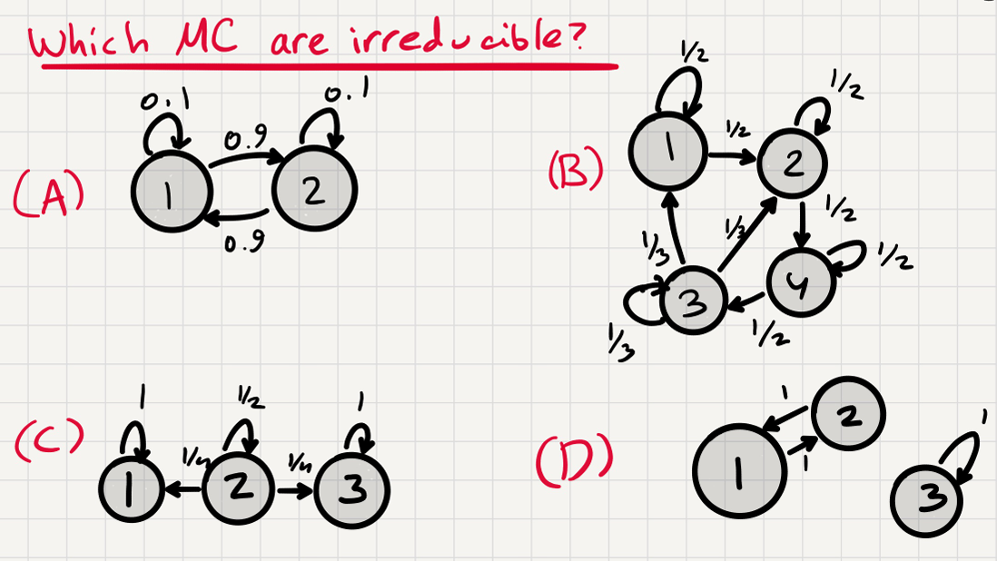

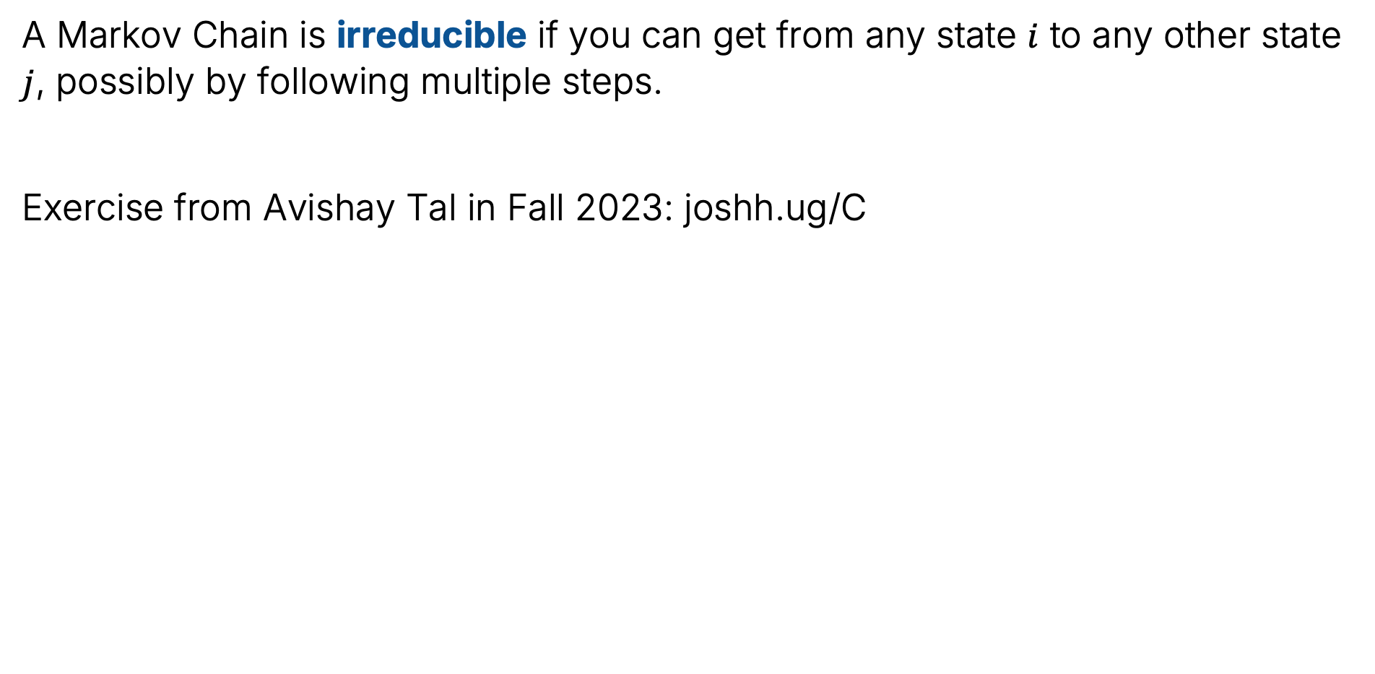
Irreducible Markov Chains
A Markov Chain is irreducible if you can get from any state $i$ to any other state $j$, possibly by following multiple steps.
Exercise from Avishay Tal in Fall 2023: joshh.ug/C

Slide 14
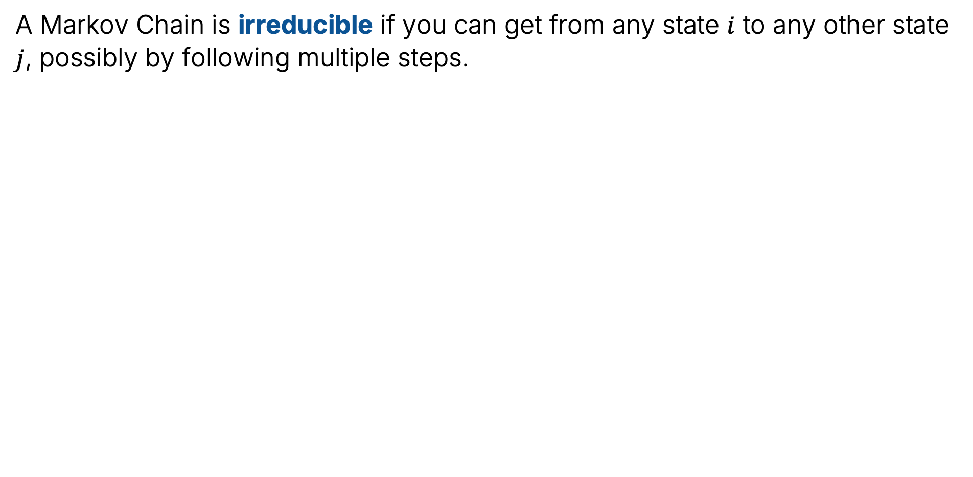
Irreducible Markov Chains
A Markov Chain is irreducible if you can get from any state $i$ to any other state $j$, possibly by following multiple steps.

Slide 15
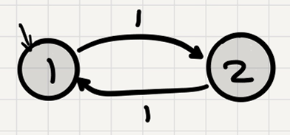
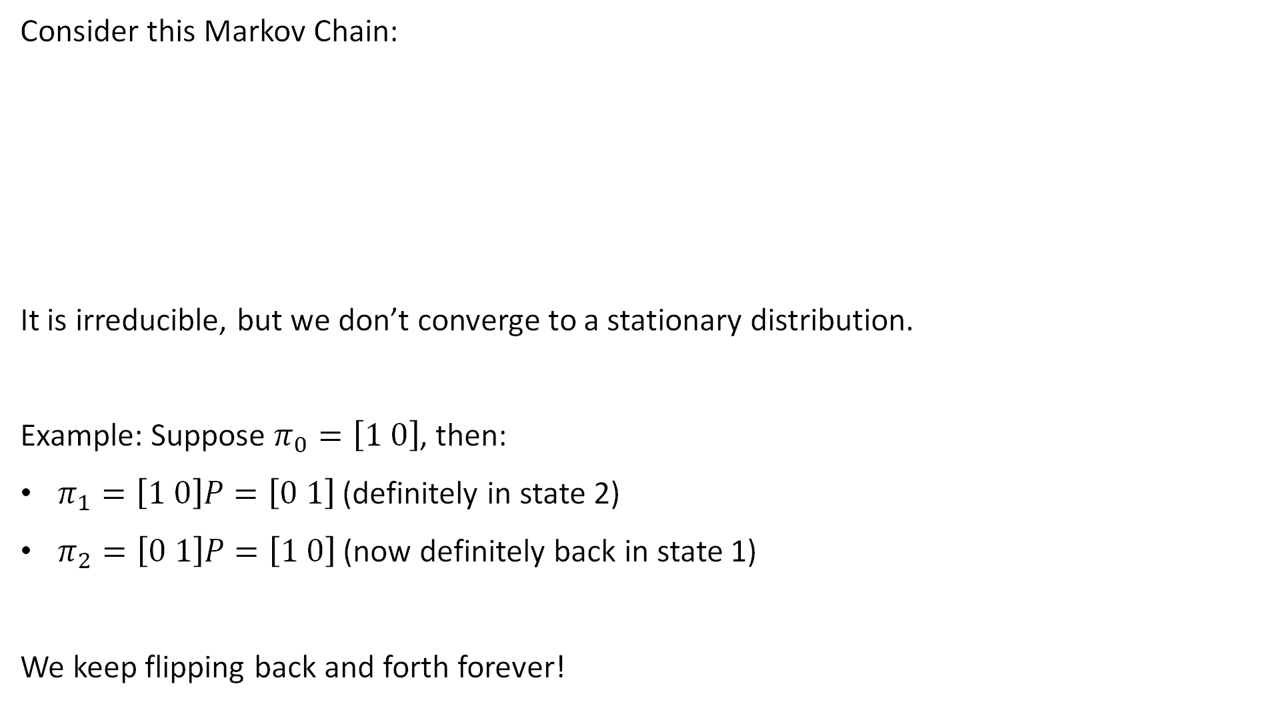
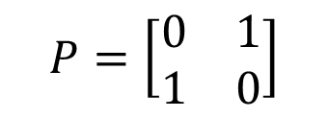
Irreducibility is Not Enough
Consider this Markov Chain:
It is irreducible, but we don’t converge to a stationary distribution.
Example: Suppose $π_{0}=\left[1 0\right]$, then:
$π_{1}=\left[1 0\right]P=\left[0 1\right]$ (definitely in state 2)
$π_{2}=\left[0 1\right]P=\left[1 0\right]$ (now definitely back in state 1)
We keep flipping back and forth forever!
$$P=\left[\begin{matrix}0 & 1 \\ 1 & 0\end{matrix}\right]$$

Slide 16
Periodicity
The periodicity of a Markov Chain with transition matrix P is the gcd of the lengths of all closed walks (loops) in the chain.
Example:
gcd of all length of all closed loops, which is 2.

Slide 17

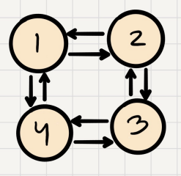
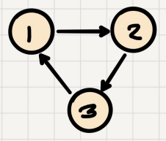
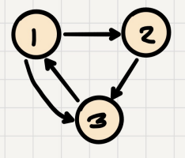
Periodicity
The periodicity of a Markov Chain with transition matrix P is the gcd of the lengths of all closed walks (loops) in the chain.
More examples: What do you think are the periods of these graphs?
joshh.ug/D

Slide 18
Periodicity
The periodicity of a Markov Chain with transition matrix P is the gcd of the lengths of all closed walks (loops) in the chain.
More examples: What do you think are the periods of these graphs?
Period: 3
Period: gcd(2, 4)=2
Period: gcd(2, 3)=1

Slide 19
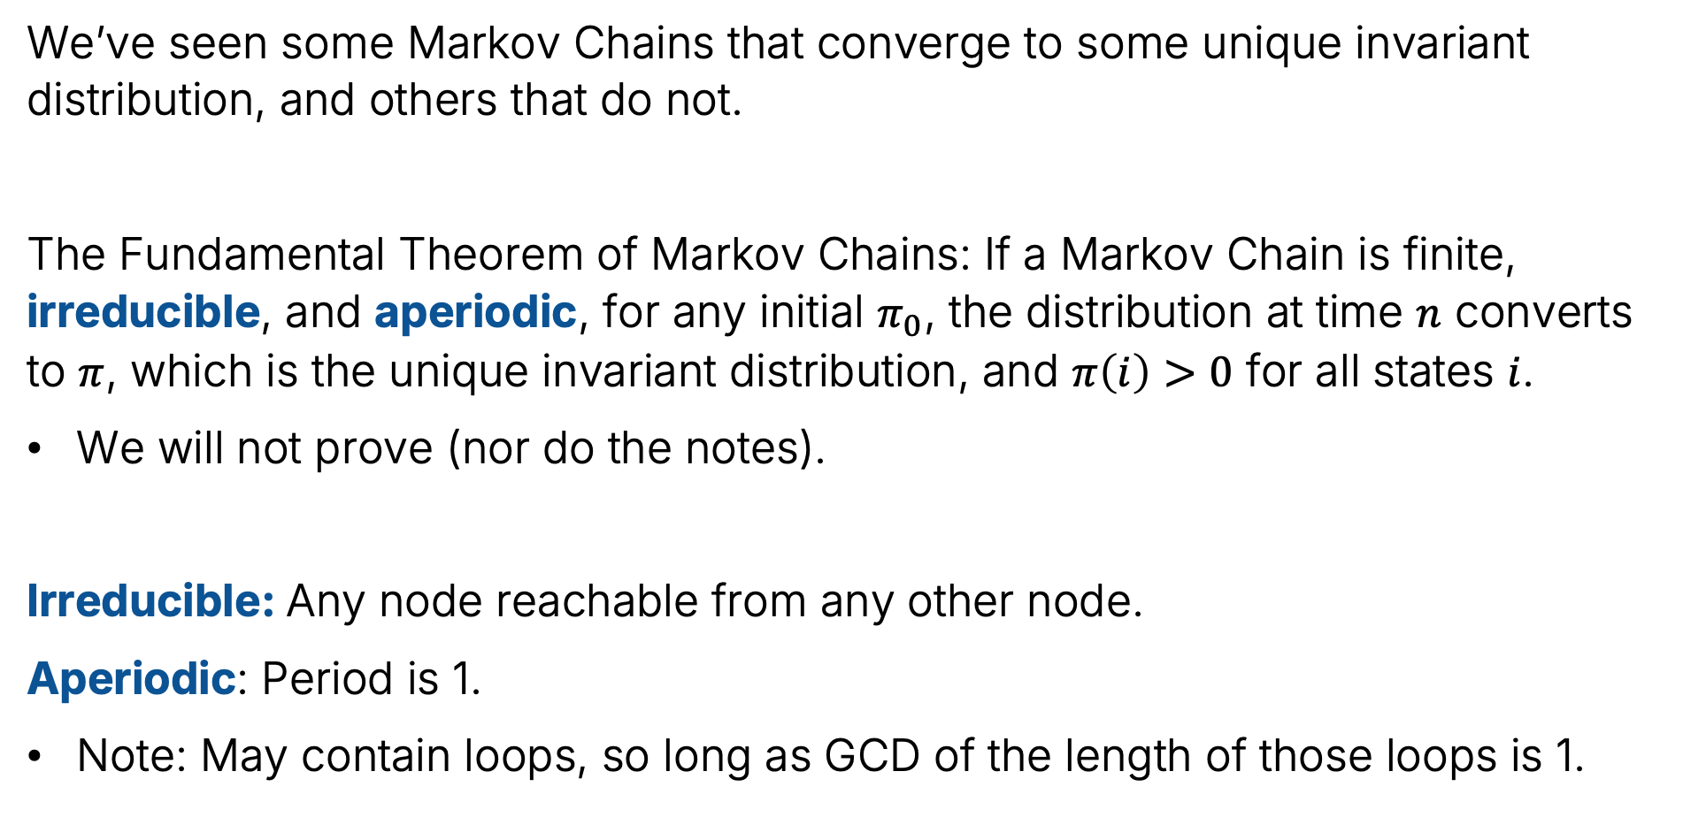
The Fundamental Theorem of Markov Chains
We’ve seen some Markov Chains that converge to some unique invariant distribution, and others that do not.
The Fundamental Theorem of Markov Chains: If a Markov Chain is finite, irreducible, and aperiodic, for any initial $π_{0}$, the distribution at time $n$ converts to $π$, which is the unique invariant distribution, and $π\left(i\right)>0$ for all states $i$.
We will not prove (nor do the notes).
Irreducible: Any node reachable from any other node.
Aperiodic: Period is 1.
Note: May contain loops, so long as GCD of the length of those loops is 1.

Slide 20
Generating Text with a Markov Chain
The Stationary Distribution (Continued)
Irreducibility and Periodicity
Generating Text with a Markov Chain
Word Level Markov Chains
Brief Look at Large Language Models
Embeddings and Tokenization
Modifying Token Meaning with Vector Operations
Generating Next Token Using Enriched Tokens
Reflections on CS70
Lecture 26, CS70 Fall 2025

Slide 21
Claude Shannon: A Mathematical Theory of Communication (1948)
In 1948, Claude Shannon wrote a paper called “A Mathematical Theory of Communication”.
Earliest example of a generative language model with which I’m familiar.
Simplest model:
Simply generate letters totally randomly from the set {A, B, C, D, …, Z, SPACE}.
Example sequence (from Shannon’s paper): XFOML RXKHRJFFJUJ ZLPWCFWKCYJ FFJEYVKCQSGHYD QPAAMKBZAACIBZLHJQD

Slide 22
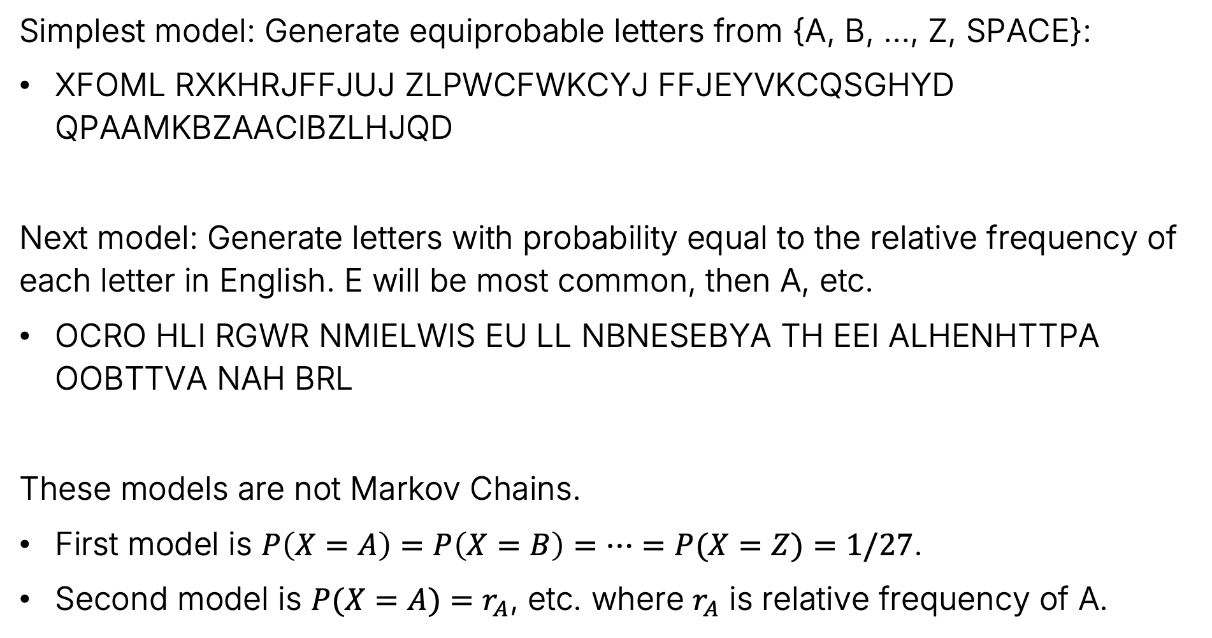
Claude Shannon: A Mathematical Theory of Communication (1948)
Simplest model: Generate equiprobable letters from {A, B, …, Z, SPACE}:
XFOML RXKHRJFFJUJ ZLPWCFWKCYJ FFJEYVKCQSGHYD QPAAMKBZAACIBZLHJQD
Next model: Generate letters with probability equal to the relative frequency of each letter in English. E will be most common, then A, etc.
OCRO HLI RGWR NMIELWIS EU LL NBNESEBYA TH EEI ALHENHTTPA OOBTTVA NAH BRL
These models are not Markov Chains.
First model is $P\left(X=A\right)=P\left(X=B\right)=…=P(X=Z)=1/27$.
Second model is $P(X=A)=r_{A}$, etc. where $r_{A}$ is relative frequency of A.

Slide 23
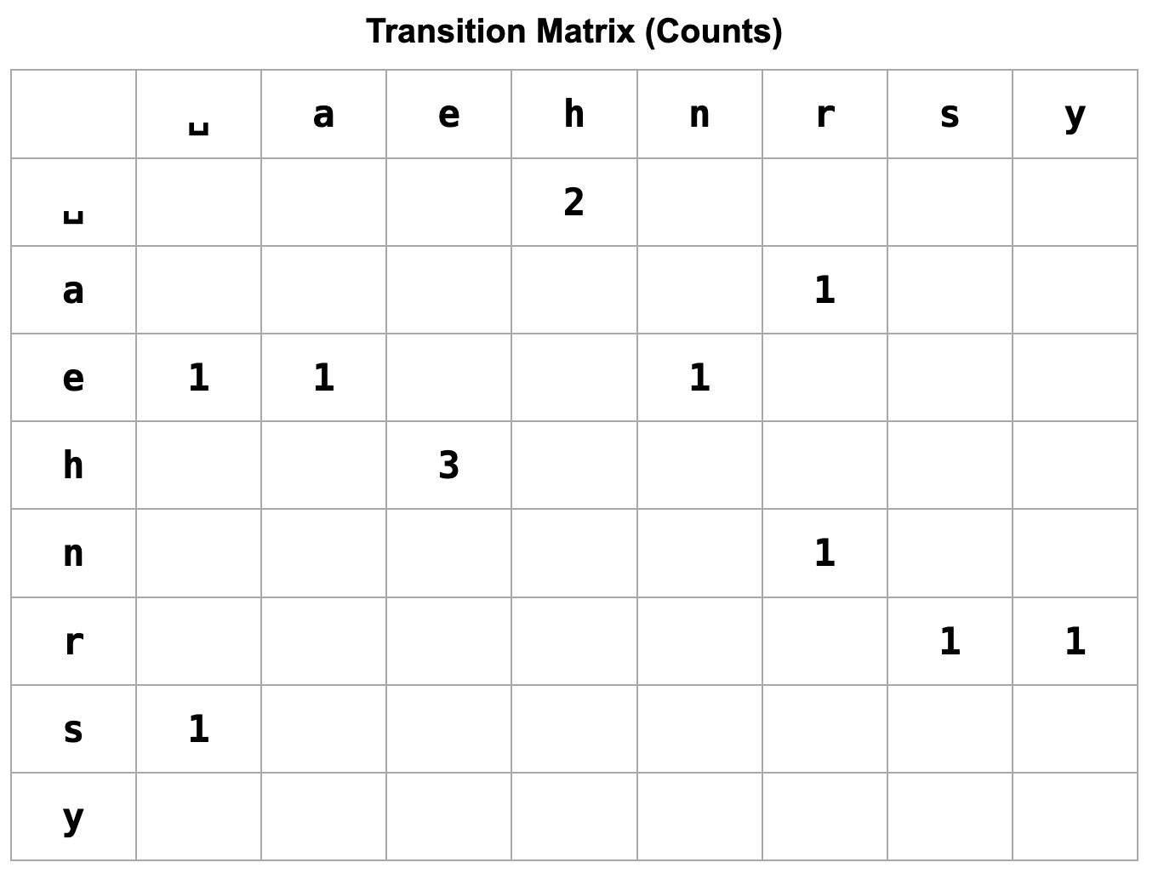
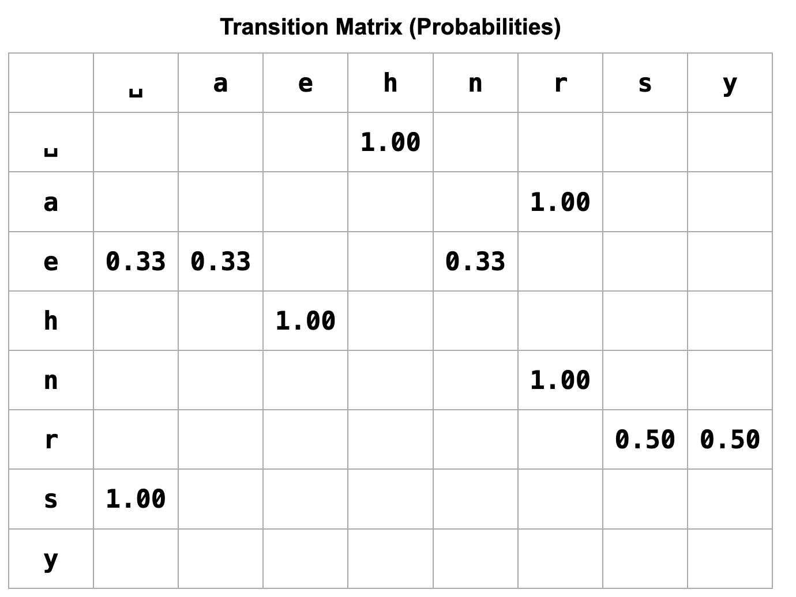
The 2-Gram Model
Shannon’s next model is called a bi-gram model (or 2-gram model).
A bi-gram model is a Markov model. Next letter depends only on previous.
Idea: Model the transition probabilities between letters in English text(s).
Example: Model for “he hears henry” (https://joshh.ug/cs70/2gram_naive.html)

Slide 24
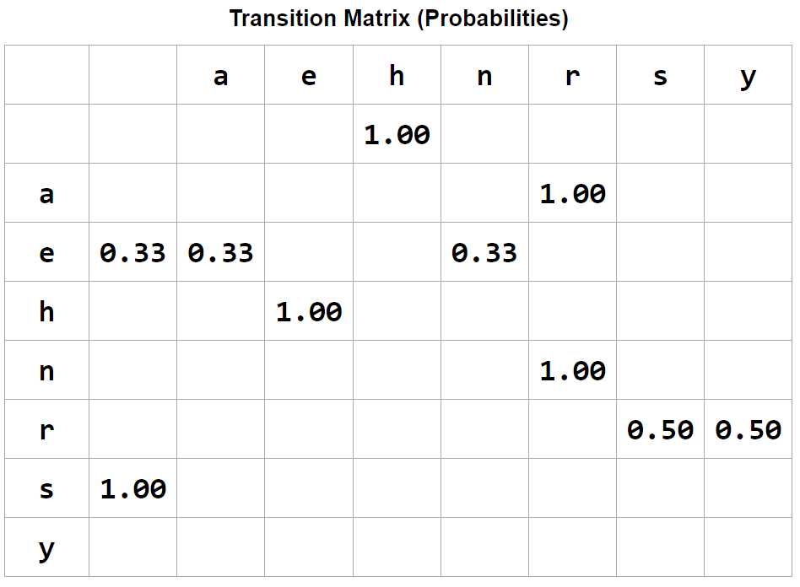
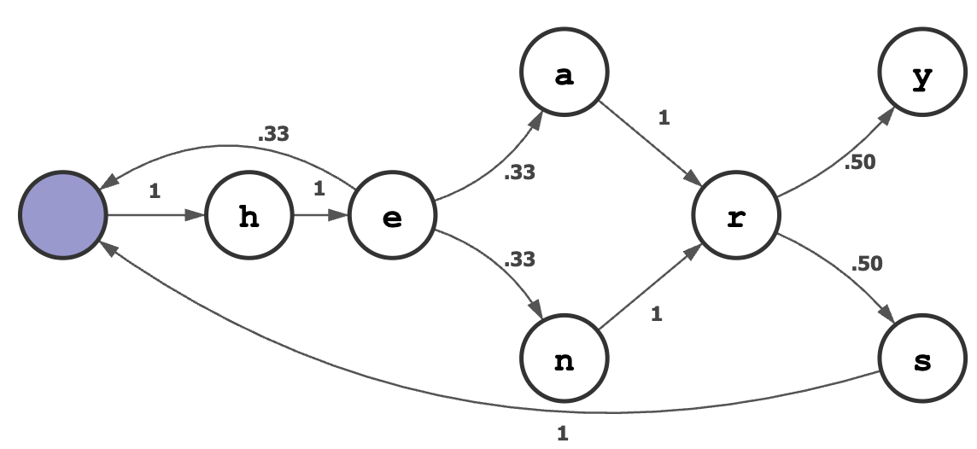
The 2-Gram Model
Of course, a transition probability matrix is the same thing as a graph.
Below, we see a graph visualization of the Marko Model we just built.
But there’s a problem. Does anyone spot it?

Slide 25
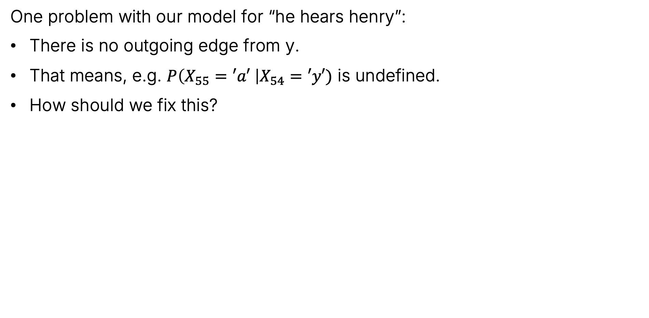
The 2-Gram Model
One problem with our model for “he hears henry”:
There is no outgoing edge from y.
That means, e.g. $P\left(X_{55}=′a′ \right|X_{54}=′y′)$ is undefined.
How should we fix this?

Slide 26
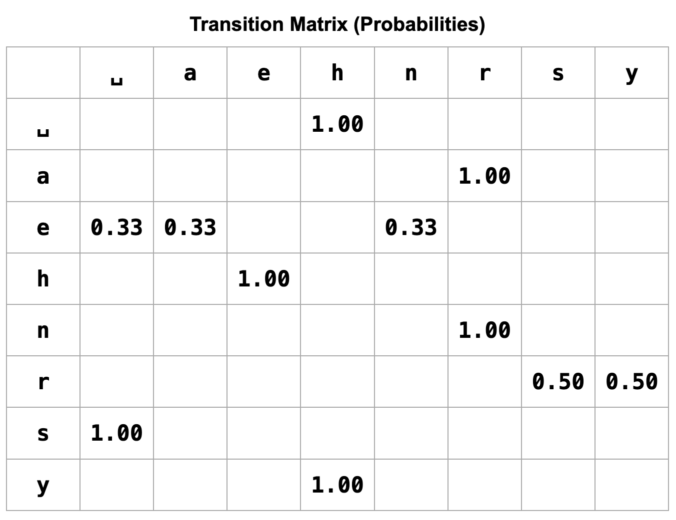
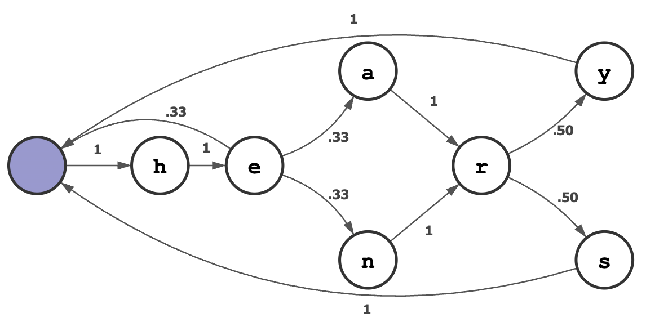
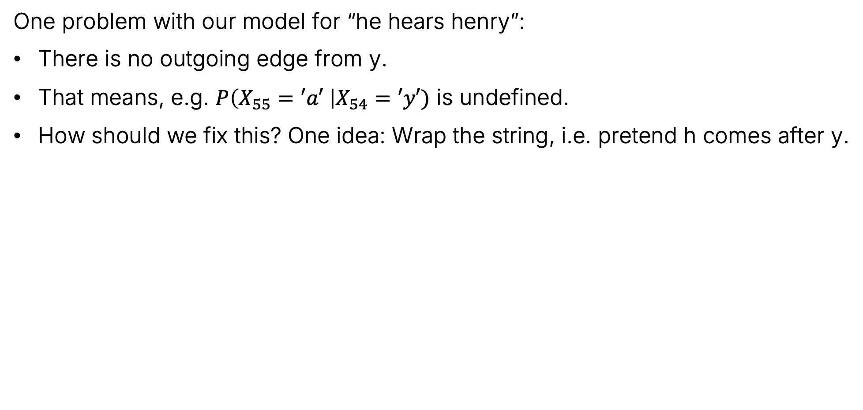
The 2-Gram Model
One problem with our model for “he hears henry”:
There is no outgoing edge from y.
That means, e.g. $P\left(X_{55}=′a′ \right|X_{54}=′y′)$ is undefined.
How should we fix this? One idea: Wrap the string, i.e. pretend h comes after y.

Slide 27
The 2-Gram Model
Let’s now use our Markov Model for “he hears henry” to generate new text (https://joshh.ug/cs70/henry.html).
We’ll provide some text, and the model will autocomplete the text.

Slide 28
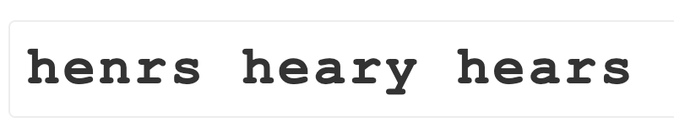
The 2-Gram Model
Let’s now use our Markov Model for “he hears henry” to generate new text (https://joshh.ug/cs70/henry.html).
We’ll provide some text, and the model will autocomplete the text.

Slide 29
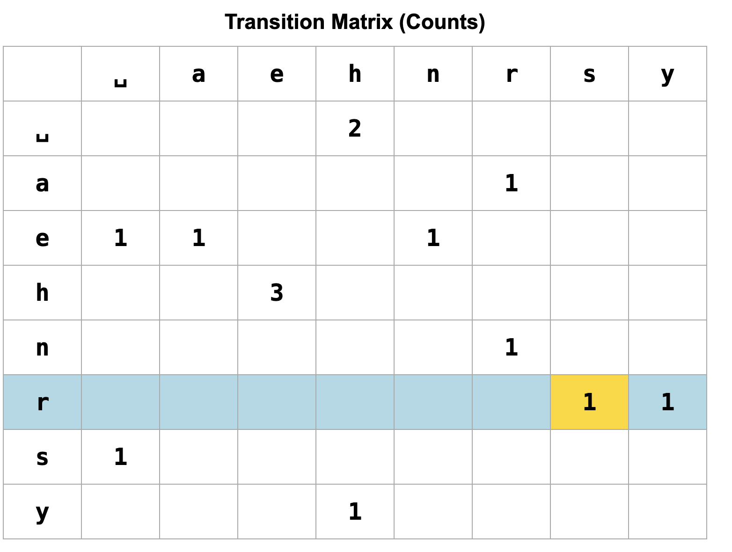
The 2-Gram Model
The models we build in the rest of lecture are going to be annoyingly large to display as a graph. Let’s instead see run an animation on the original page we used to build the model.
https://joshh.ug/cs70/2gram.html

Slide 30
The 2-Gram Model
Let’s try a bigger model: “the cat is riding on a bicycle. we are all impressed with the cat’s abilities.”
With this richer dataset, maybe we’ll get richer outputs?
Notes:
cath imprit ong riss on ticycat’sse wid

Slide 31
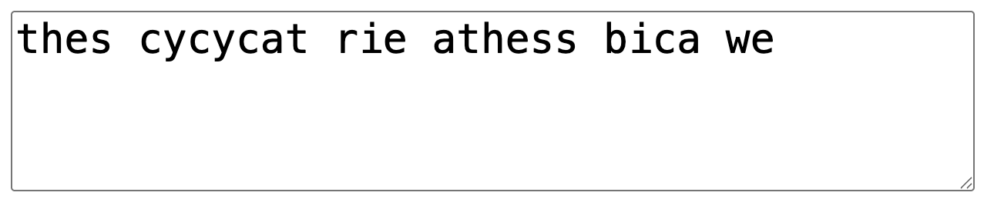
The 2-Gram Model
Let’s try a bigger model: “the cat is riding on a bicycle. we are all impressed with the cat’s abilities.”
Still pretty weird! Let’s try using more data, e.g. the first few paragraphs of Moby Dick: https://www.gutenberg.org/files/2701/old/moby10b.txt

Slide 32
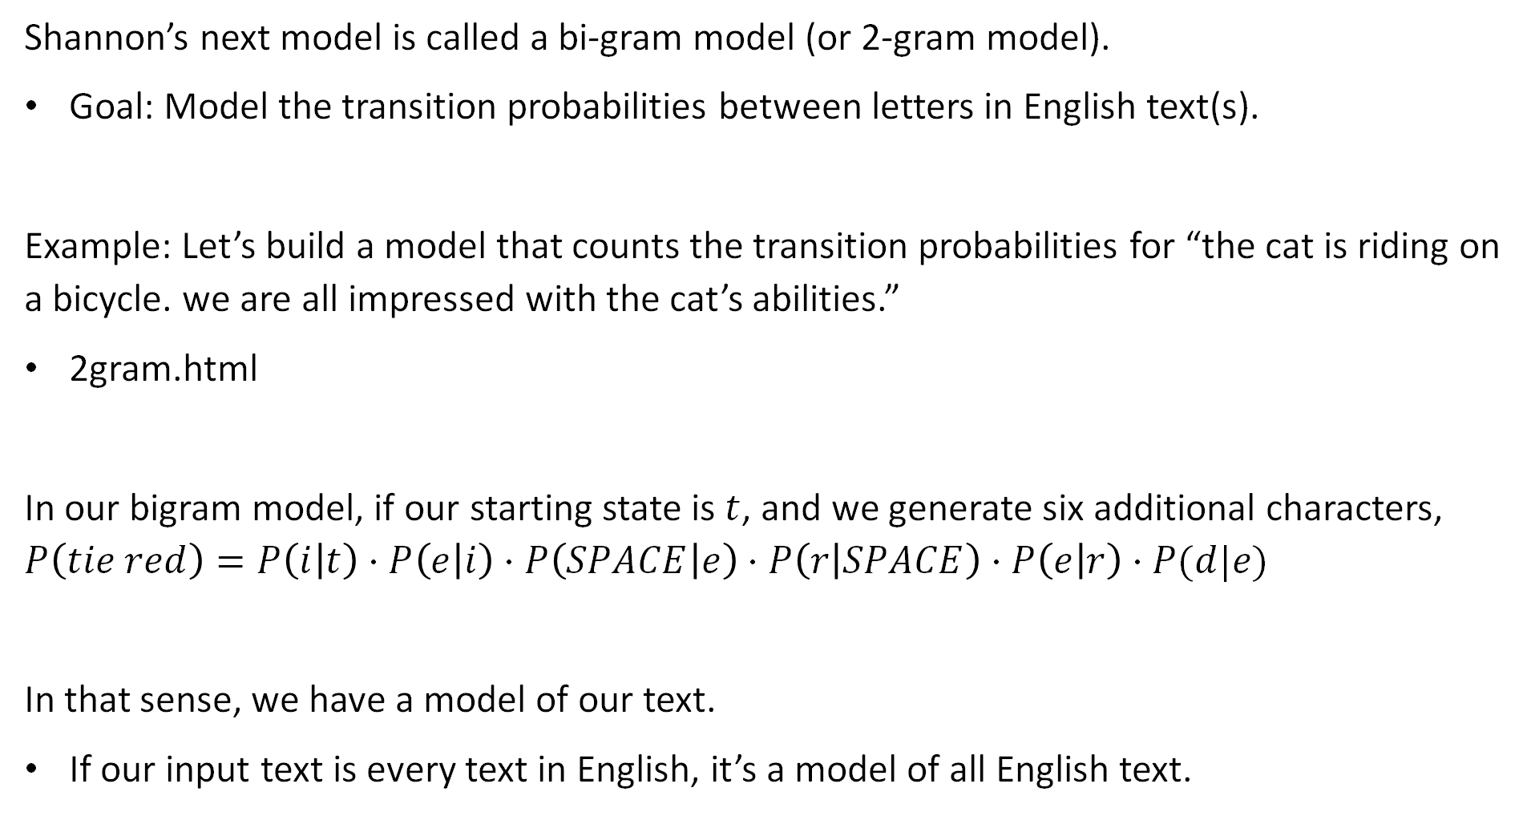
The 2-Gram Model
Shannon’s next model is called a bi-gram model (or 2-gram model).
Goal: Model the transition probabilities between letters in English text(s).
Example: Let’s build a model that counts the transition probabilities for “the cat is riding on a bicycle. we are all impressed with the cat’s abilities.”
2gram.html
In our bigram model, if our starting state is $t$, and we generate six additional characters, $P\left(tie red\right)=P\left(i | t\right)⋅P\left(e | i\right)⋅P\left(SPACE | e\right)⋅P\left(r | SPACE\right)⋅P\left(e | r\right)⋅P(d|e)$
In that sense, we have a model of our text.
If our input text is every text in English, it’s a model of all English text.

Slide 33
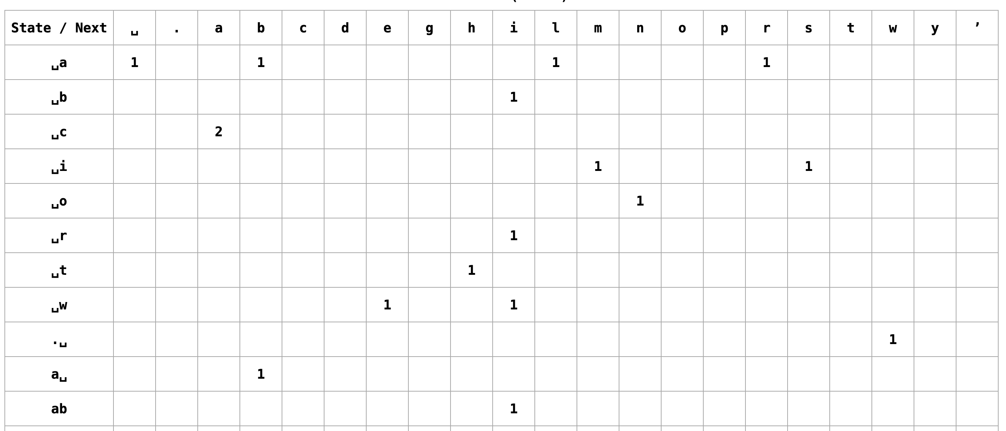
The 3-Gram Model
Let’s try a 3-gram model.
Idea: Predict the next letter based on the previous two letters.
Let’s try this out with “the cat is riding on a bicycle. we are all impressed with the cat’s abilities.”: kgram.html

Slide 34
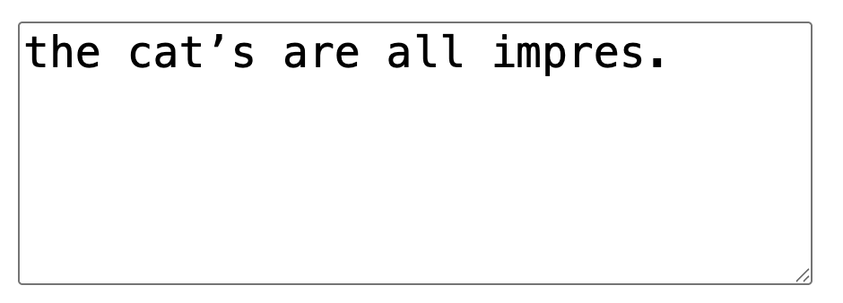
The 3-Gram Model
Let’s try a 3-gram model.
Idea: Predict the next letter based on the previous two letters.
Let’s try this out with “the cat is riding on a bicycle. we are all impressed with the cat’s abilities.”: https://joshh.ug/cs70/kgram.html
Looks better!

Slide 35
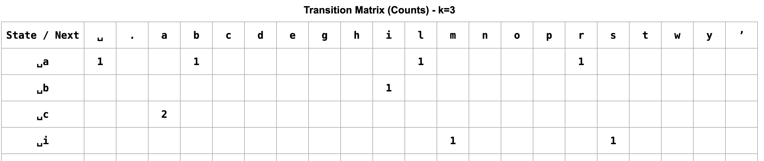
The 3-Gram Model
Question: Is this model a Markov Model?

Slide 36
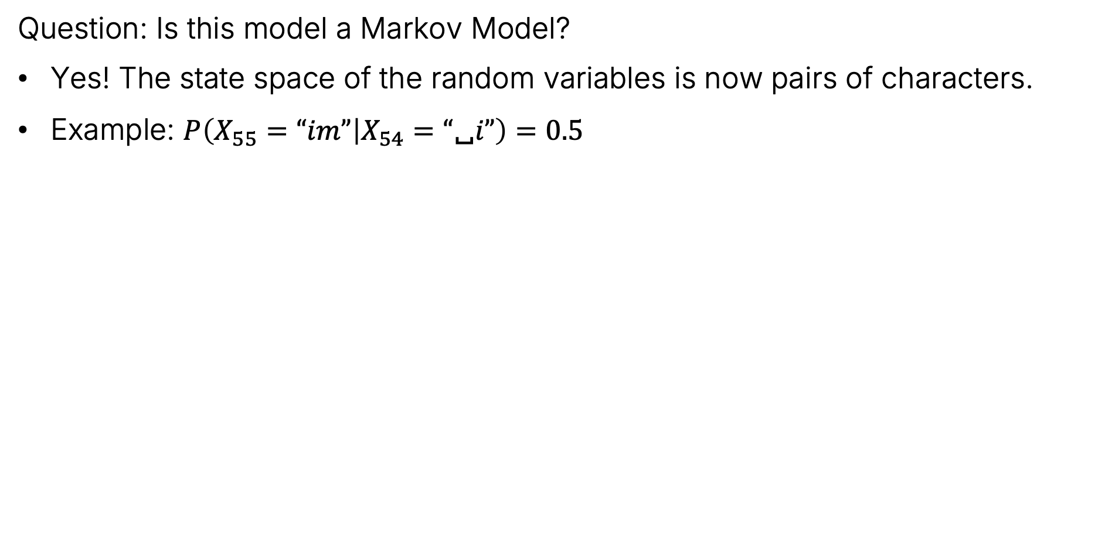
The 3-Gram Model
Question: Is this model a Markov Model?
Yes! The state space of the random variables is now pairs of characters.
Example: $P\left(X_{55}=“im” | X_{54}=“\text{␣}i”\right)=0.5$

Slide 37
The 3-Gram Model
Let’s try out our 3-gram model with Moby Dick again.
https://joshh.ug/cs70/kgram.html

Slide 38

The 3-Gram Model
Model Interpretation:
Suppose we start from “th”.
“$\text{␣}$impres.” as the last 8 characters given that the previous 2 characters were “$\text{␣}i$”?
Can use chain rule:
$$P\left(”\text{␣}impres.”|”\text{␣}i”\right)=P\left(”s.” | ”es”\right)⋅P\left(”es” | ”re”\right)⋅P\left(”re” | ”pr”\right)⋅P\left(”pr” | ”mp”\right)⋅P\left(“mp” | ”im”\right)⋅$$

Slide 39

The 3-Gram Model
Let’s try a 3-gram model.
Idea: Predict the next letter based on the previous two letters.
Let’s try this out with “the cat is riding on a bicycle. we are all impressed with the cat’s abilities”: kgram.html
If we use “the cat is riding on a bicycle. we are all impressed with the cat’s abilities.”, and use “ti” as our starting sequence, then the chance that we get “tie red” is:
$$P\left(tie red\right)=P\left(e | ti\right)⋅P\left(SPACE | ie\right)⋅P\left(r | eSPACE\right)⋅P\left(e | rSPACE\right)⋅P(d|re)$$

Slide 40
4-Gram Models and Beyond
Naturally, we can also take into account more of our recent characters.
Example, for a 5-gram model, our current state is the most recent four characters.
Let’s lastly try out 5-gram model of Moby Dick and see what happens.
https://joshh.ug/cs70/kgram.html

Slide 41


5 Gram Model Output
Naturally, we can also take into account more of our recent characters.
Example, for a 5-gram model, our current state is the most recent four characters.
Let’s lastly try out 5-gram model of Moby Dick and see what happens.

Slide 42

CS70 Perspectie
Can think of our Markov Model as being able to tell us the chance that we get a specific autocompletion given a starter string. $P(“captain, or my purselves you this deep”…|”capt”)$.
In fact, we can compute the exact probability using the chain rule:
$$P\left(“captain, or my purselves you this deep”… | ”capt”\right)=$$ $P(X_{1}=“apta”\left|X_{0}=”capt”\right)⋅P\left(X_{2}=“ptai” | X_{1}=”apta”\right)⋅P\left(X_{3}=“tain” | ”X_{2}=“ptai”\right)⋅…$

Slide 43
CS70 Perspectie
Can think of our Markov Model as being able to tell us the chance that we get a specific autocompletion given a starter string. $P(“captain, or my purselves you this deep”…|”capt”)$.
In fact, we can compute the exact probability using the chain rule:
$$P\left(“captain, or my purselves you this deep”… | ”capt”\right)=$$ $P(X_{1}=“apta”\left|X_{0}=”capt”\right)⋅P\left(X_{2}=“ptai” | X_{1}=”apta”\right)⋅P\left(X_{3}=“tain” | ”X_{2}=“ptai”\right)⋅…$

Slide 44
CS70 Perspectie
Can think of our Markov Model as being able to tell us the chance that we get a specific autocompletion given a starter string. $P(“captain, or my purselves you this deep”…|”capt”)$.
In fact, we can compute the exact probability using the chain rule:
$$P\left(“captain, or my purselves you this deep”… | ”capt”\right)=$$ $P(X_{1}=“apta”\left|X_{0}=”capt”\right)⋅P\left(X_{2}=“ptai” | X_{1}=”apta”\right)⋅P\left(X_{3}=“tain” | ”X_{2}=“ptai”\right)⋅…$

Slide 45
CS70 Perspectie
Can think of our Markov Model as being able to tell us the chance that we get a specific autocompletion given a starter string. $P(“captain, or my purselves you this deep”…|”capt”)$.
In fact, we can compute the exact probability using the chain rule:
$$P\left(“captain, or my purselves you this deep”… | ”capt”\right)=$$ $P(X_{1}=“apta”\left|X_{0}=”capt”\right)⋅P\left(X_{2}=“ptai” | X_{1}=”apta”\right)⋅P\left(X_{3}=“tain” | ”X_{2}=“ptai”\right)⋅…$

Slide 46

CS70 Perspectie
More data and higher order Markov models seem to be giving us a better model for English text.
Example, 1gram model won’t be particularly excited about $P(“captain, or my purselves you this deep”…|”capt”)$.
But 5gram model will give a much higher value for this probability.
If we sample from these high quality distributions, we text that looks better.

Slide 47


Beyond English
In principle, this type of model can use any string of characters from any alphabet.
Notes:
詞曰：
滾滾長江東逝水，浪花淘盡英雄。是非成敗轉頭空：青山依舊在，幾度夕陽紅。白 髮漁樵江渚上，慣看秋月春風。一壺濁酒喜相逢：古今多少事，都付笑談中。
話說天下大勢，分久必合，合久必分：周末七國分爭，并入於秦。及秦滅之後，楚 、漢分爭，又并入於漢。漢朝自高祖斬白蛇而起義，一統天下。後來光武中興，傳至獻 帝，遂分為三國。推其致亂之由，殆始於桓、靈二帝。桓帝禁錮善類，崇信宦官。及桓 帝崩，靈帝即位，大將軍竇武、太傅陳蕃，共相輔佐。時有宦官曹節等弄權，竇武、陳 蕃謀誅之，作事不密，反為所害。中涓自此愈橫。
建寧二年四月望日，帝御溫德殿。方陞座，殿角狂風驟起，只見一條大青蛇，從梁 上飛將下來，蟠於椅上。帝驚倒，左右急救入宮，百官俱奔避。須臾，蛇不見了。忽然 大雷大雨，加以冰雹，落到半夜方止，壞卻房屋無數。建寧四年二月，洛陽地震；又海 水泛溢，沿海居民，盡被大浪捲入海中。光和元年，雌雞化雄。六月朔，黑氣十餘丈， 飛入溫德殿中。秋七月，有虹見於玉堂；五原山岸，盡皆崩裂。種種不祥，非止一端。
帝下詔問群臣以災異之由，議郎蔡邕上疏，以為蜺墮雞化，乃婦寺干政之所致，言 頗切直。帝覽奏歎息，因起更衣。曹節在後竊視，悉宣告左右。遂以他事陷邕於罪，放 歸田里。後張讓，趙忠，封諝，段珪，曹節，候覽，蹇碩，程曠，夏惲，郭勝十人朋比 為奸，號為「十常侍」。帝尊信張讓，呼為「阿父」，朝政日非，以致天下人心思亂， 盜賊蜂起。
時鉅鹿郡有兄弟三人：一名張角，一名張寶，一名張梁。那張角本是個不第秀才。 因入山採藥，遇一老人，碧眼童顏，手執藜杖，喚角至一洞中，以天書三卷授之，曰： 「此名太平要術。汝得之，當代天宣化，普救世人；若萌異心，必獲惡報。」角拜問姓 名。老人曰：「吾乃南華老仙也。」言訖，化陣清風而去。
角得此書，曉夜攻習，能呼風喚雨，號為太平道人。中平元年正月內，疫氣流行， 張角散施符水，為人治病，自稱大賢良師。角有徒弟五百餘人，雲游四方，皆能書符念 咒。次後徒眾日多，角乃立三十六方，─大方萬餘人，小方六七千─，各立渠帥，稱為 將軍。訛言「蒼天已死，黃天當立。」又云「歲在甲子，天下大吉。」令人各以白土， 書「甲子」二字於家中大門上。青、幽、徐、冀、荊、揚、兗、豫八州之人，家家侍奉 大賢良師張角名字。角遣其黨馬元義，暗齎金帛，結交中涓封諝，以為內應。角與二弟 商議曰：「至難得者，民心也。今民心已順，若不乘勢取天下，誠為可惜。」遂一面私 造黃旗，約期舉事；一面使弟子唐州，馳書報封諝。唐州乃逕赴省中告變。帝召大將軍 何進調兵擒馬元義，斬之；次收封諝等一干人下獄。
張角聞知事露，星夜舉兵，自稱天公將軍，─張寶稱地公將軍，張梁稱人公將軍─ 。申言於眾曰：「今漢運將終，大聖人出﹔汝等皆宜順從天意，以槳太平。」四方百姓 ，裹黃巾從張角反者，四五十萬。賊勢浩大，官軍望風而靡。何進奏帝火速降詔，令各 處備禦，討賊立功；一面遣中郎將盧植，皇甫嵩，朱雋，各引精兵，分三路討之。
且說張角一軍，前犯幽州界分。幽州太守劉焉，乃江夏竟陵人氏，漢魯恭王之後也 ；當時聞得賊兵將至，召校尉鄒靖計議。靖曰：「賊兵眾，我兵寡，明公宜作速招軍應 敵。」劉焉然其說，隨即出榜招募義兵。榜文行到涿縣，乃引出涿縣中一個英雄。
那人不甚好讀書；性寬和，寡言語，喜怒不形於色；素有大志，專好結交天下豪傑 ；生得身長七尺五寸，兩耳垂肩，雙手過膝，目能自顧其耳，面如冠玉，脣若塗脂；中 山靖王劉勝之後，漢景帝閣下玄孫﹔姓劉，名備，字玄德。昔劉勝之子劉貞，漢武時封 涿鹿亭侯，後坐酬金失侯，因此遺這一枝在涿縣。玄德祖劉雄，父劉弘。弘曾舉孝廉， 亦嘗作吏，早喪。玄德幼孤，事母至孝；家貧，販屨織蓆為業。家住本縣樓桑村。其家 之東南，有一大桑樹，高五丈餘，遙望之，童童如車蓋。相者云：「此家必出貴人。」
玄德幼時，與鄉中小兒戲於樹下，曰：「我為天子，當乘此車蓋。」叔父劉元起奇 其言，曰：「此兒非常人也！」因見玄德家貧，常資給之。年十五歲，母使游學，嘗師 事鄭玄、盧植；與公孫瓚等為友。及劉焉發榜招軍時，玄德年己二十八歲矣。當日見了 榜文，慨然長歎。隨後一人厲聲言曰：「大丈夫不與國家出力，何故長歎？」
玄德回視其人：身長八尺，豹頭環眼，燕頷虎鬚，聲若巨雷，勢如奔馬。玄德見他 形貌異常，問其姓名。其人曰：「某姓張，名飛，字翼德。世居涿郡，頗有莊田，賣酒 屠豬，專好結交天下豪傑。適纔見公看榜而歎，故此相問。」玄德曰：「我本漢室宗親 ，姓劉，名備。今聞黃巾倡亂，有志欲破賊安民；恨力不能，故長歎耳。」飛曰：「吾 頗有資財，當招募鄉勇，與公同舉大事，如何？」玄德甚喜，遂與同入村店中飲酒。
正飲間，見一大漢，推著一輛車子，到店門首歇了；入店坐下，便喚酒保：「快斟 酒來吃，我待趕入城去投軍。」玄德看其人：身長九尺，髯長二尺：面如重棗，脣若塗 脂；丹鳳眼，臥蠶眉：相貌堂堂，威風凜凜。玄德就邀他同坐，叩其姓名。其人曰：「 吾姓關，名羽，字壽長，後改雲長，河東解良人也。因本處勢豪，倚勢凌人，被吾殺了 ；逃難江湖，五六年矣。今聞此處招軍破賊，特來應募。」玄德遂以己志告之。雲長大 喜。同到張飛莊上，共議大事。
飛曰：「吾莊後有一桃園，花開正盛；明日當於園中祭告天地，我三人結為兄弟， 協力同心，然後可圖大事。」玄德、雲長、齊聲應曰：「如此甚好。」次日，於桃園中 ，備下烏牛白馬祭禮等項，三人焚香，再拜而說誓曰：「念劉備、關羽、張飛，雖然異 姓，既結為兄弟，則同心協力，救困扶危；上報國家，下安黎庶；不求同年同月同日生 ，但願同年同月同日死。皇天后土，實鑒此心。背義忘恩，天人共戮。」誓畢，拜玄德 為兄，關羽次之，張飛為弟。祭罷天地，復宰牛設酒，聚鄉中勇士，得三百餘人，就桃 園中痛飲一醉。來日收拾軍器，但恨無馬匹可乘。
正思慮間，人報「有兩個客人，引一夥伴儅，趕一群馬，投莊上來。」玄德曰：「 此天佑我也！」三人出莊迎接。原來二客乃中山大商：一名張世平，一名蘇雙，每年往 北販馬，近因寇發而回。玄德請二人到莊，置酒管待，訴說欲討賊安民之意。二客大喜 ，願將良馬五十匹相送；又贈金銀五百兩，鑌鐵一千斤，以資器用。玄德謝別二客，便 命良匠打造雙股劍。雲長造青龍偃月刀，又名冷豔鋸，重八十二斤。張飛造丈八點鋼矛 。各置全身鎧甲。共聚鄉勇五百餘人，來見鄒靖。鄒靖引見太守劉焉。三人參見畢，各 通姓名。玄德說起宗派，劉焉大喜，遂認玄德為姪。
不數日，人報黃巾賊將程遠志統兵五萬來犯涿郡。劉焉令鄒靖引玄德等三人，統兵 五百，前去破敵。玄德等欣然領軍前進，直至大興山下，與賊相見。賊眾皆披髮，以黃 巾抹額。當下兩軍相對，玄德出馬，─左有雲長，右有翼德─，揚鞭大罵：「反國逆賊 ，何不早降！」
程遠志大怒，遣副將鄧茂出戰。張飛挺丈八蛇矛直出，手起處，刺中鄧茂心窩，翻 身落馬。程遠志見折了鄧茂，拍馬舞刀，直取張飛。雲長舞動大刀，縱馬飛迎。程遠志 見了，早吃一驚；措手不及，被雲長刀起處，揮為兩段。後人有詩讚二人曰：
英雄發穎在今朝，一試矛兮一試刀。初出便將威力展，三分好把姓名標。
眾賊見程遠志被斬，皆倒戈而走。玄德揮軍追趕，投降者不計其數，大勝而回。劉 焉親自迎接，賞勞軍士。次日，接得青州太守龔景牒文，言黃巾賊圍城將陷，乞賜救援 。劉焉與玄德商議。玄德曰：「備願往救之。」劉焉令鄒靖將兵五千，同玄德，關，張 ，投青州來。賊眾見救軍至，分兵混戰。玄德兵寡不勝，退三十里下寨。玄德謂關、張 曰、「賊眾我寡，必出奇兵，方可取勝。」乃分關公引一千軍伏山左，張飛引一千軍伏 山右，鳴金為號，齊出接應。
次日，玄德與鄒靖，引軍鼓譟而進。賊眾迎戰，玄德引軍便退。賊眾乘勢追趕，方 過山嶺，玄德軍中一齊鳴金，左右兩軍齊出，玄德麾軍回身復殺。三路夾攻，賊眾大潰 。直趕至青州城下，太守龔景亦率民兵出城助戰。賊勢大敗，剿戮極多，遂解青州之圍 。後人有詩讚玄德曰：

Slide 48
Shannon’s Model Outputs
Fun fact: Shannon tried out these models way back in his original paper.
0-gram: XFOML RXKHRJFFJUJ ZLPWCFWKCYJ FFJEYVKCQSGHYD QPAAMKBZAACIBZLHJQD
1-gram: OCRO HLI RGWR NMIELWIS EU LL NBNESEBYA TH EEI ALHENHTTPA OOBTTVA NAH BRL
2-gram: ON IE ANTSOUTINYS ARE T INCTORE ST BE S DEAMY ACHIN D ILONASIVE TUCOOWEATTEASONAREFUSOTIZINANDYTOBESEACECTISBE
3-gram: IN NO IST LAT WHEY CRATICT FROURE BIRS GROCID PONDENOME OF DEMONSTURES OF THE REPTAGIN IS REGOACTIONA OF CRE.
Note: Shannon generated these outputs without a computer (not yet available).
See the paper for details on how he did this.

Slide 49
Word Level Markov Chains
The Stationary Distribution (Continued)
Irreducibility and Periodicity
Generating Text with a Markov Chain
Word Level Markov Chains
Brief Look at Large Language Models
Embeddings and Tokenization
Modifying Token Meaning with Vector Operations
Generating Next Token Using Enriched Tokens
Reflections on CS70
Lecture 26, CS70 Fall 2025

Slide 50


Markov Chains
You can build a Markov Chain of words (instead of letters).
Demo: kgram_words.html for “my name is josh. josh is my name. my hand is my hand.”
Note: To keep things tidy, this simulator strips all characters except spaces and English letters.

Slide 51
Shannon’s Model Outputs
Shannon’s outputs (letter level modeling):
0-gram: XFOML RXKHRJFFJUJ ZLPWCFWKCYJ FFJEYVKCQSGHYD QPAAMKBZAACIBZLHJQD
1-gram: OCRO HLI RGWR NMIELWIS EU LL NBNESEBYA TH EEI ALHENHTTPA OOBTTVA NAH BRL
2-gram: ON IE ANTSOUTINYS ARE T INCTORE ST BE S DEAMY ACHIN D ILONASIVE TUCOOWEATTEASONAREFUSOTIZINANDYTOBESEACECTISBE
3-gram: IN NO IST LAT WHEY CRATICT FROURE BIRS GROCID PONDENOME OF DEMONSTURES OF THE REPTAGIN IS REGOACTIONA OF CRE.
Shannon’s outputs (word level modeling):
2-gram: REPRESENTING AND SPEEDILY IS AN GOOD APT OR COME CAN DIFFERENT NATURAL HERE HE THE A IN CAME THE TO OF TO EXPERT GRAY COME TO FURNISHES THE LINE MESSAGE HAD BE THESE.
3-gram: THE HEAD AND IN FRONTAL ATTACK ON AN ENGLISH WRITER THAT THE CHARACTER OF THIS POINT IST HEREFORE ANOTHER METHOD FOR THE LETTERS THAT THE TIME OF WHOEVER TOLD THE PROBLEM FOR AN UNEXPECTED.

Slide 52

High-K Word Level Markov Chains on Moby Dick
If we create a high-k word level Markov Chain to model Moby Dick, we encounter another issue:
Our model is basically just regurgitating the text it learned.

Slide 53
Limitations of K-Gram Models for Autocomplete
We have two related issues:
K-Gram models can only generate sequences that have existed before.
K-Gram models have no sense of meaning. Planning is always based on only the previous K symbols.
Having more data will help mitigate these issues, but the problem is that even an exact model of all existing English text is still not good enough.
Example: Consider the sequence “My penguin therapist reassured me with a soft pat with her ________”. The natural word to follow this is “flipper”, but the starter text does not exist in the existing English corpus.
(or at least it didn’t before I wrote it!)

Slide 54
Embeddings and Tokenization
The Stationary Distribution (Continued)
Generating Text with a Markov Chain
Word Level Markov Chains
Brief Look at Large Language Models
Embeddings and Tokenization
Modifying Token Meaning with Vector Operations
Generating Next Token Using Enriched Tokens
Reflections on CS70
Lecture 26, CS70 Fall 2025

Slide 55
Note
The following slides are out of scope for CS70. But they are a sneak preview of your potential future.

Slide 56
Better Language Modeling
Naturally, researchers built much better models than what Shannon described back in 1948. Used for all sorts of tasks, just to name a few:
Text generation.
Sentiment analysis.
Translation.
In 2017, a paper was published about a neural network architecture (see 182/188/189) called the Transformer.
In this paper, they showed that a computationally inexpensive called “Attention” was sufficient for good results on a certain language translation task. And importantly: Other more computationally expensive techniques (recurrence) that were at that time considered important were unnecessary.

Slide 57
The Consequence of the Transformer
Since transformers were so cheap to utilize, language models were able to ingest and make predictions based on much larger volumes of data.
The current models have consumed essentially all written text available online.
And the technique generalizes to other domains such as sound data and visual data.

Slide 58


The end result is that we’re able to get a MUCH better results for:
$P\left(flipper|\text{My} \text{penguin} \text{therapist} \text{reassured} \text{me} \text{with} \text{a} \text{soft} \text{pat} \text{with} \text{her}\right)$
$P\left( \right|\text{Josh} \text{Hug} \text{riding} \text{a} \text{unicorn})$

Slide 59
Tiny Peek Inside How This Works
Let’s take a very brief look into how text generation works specifically.
How the heck can we get our language model to understand that penguins have flippers.
Key idea: Embeddings.
Represent the meaning of a word (or a picture or anything else) as a vector of numbers.

Slide 60

Embedding Example
The code below loads a model that provides “embeddings” for a large number of English words.
Each word has an associated 300 number long vector called its embedding. An example for the word cow is given below. This represents all meanings of the word cow (e.g. the animal, making someone feel bad, etc).
array([ 0.18945312, -0.07519531, -0.15625 , 0.19921875, -0.18457031,
0.20703125, -0.04125977, -0.01428223, 0.00363159, -0.09570312, …

Slide 61

Embedding Demo
Let’s hop over to a Jupyter Notebook and experiment with word2vec embeddings.
[('father', 0.8103864789009094)]

Slide 62
Quick GPT Demo
Let’s try asking ChatGPT this question: “Who'd use "后" vs. "後"?”

Slide 63


Tokenization
Let’s try asking ChatGPT this question: “Who'd use "后" vs. "後"?”
The model doesn’t see this question at the word OR character level. Instead, text is broken into tokens.
https://platform.openai.com/tokenizer
Or https://gpt-tokenizer.dev/

Slide 64

Inference
The process of generating output text basically goes like this:
Who'd use "后" vs. "後"?
Pick a next token that naturally follows previous tokens.

Slide 65

Tokenization and Counting Strings
Incidentally, this is why older LLM models have trouble counting letters, e.g.
The model sees “strawberry” as a single token.

Slide 66
Modifying Token Meaning with Vector Operations
The Stationary Distribution (Continued)
Generating Text with a Markov Chain
Word Level Markov Chains
Brief Look at Large Language Models
Embeddings and Tokenization
Modifying Token Meaning with Vector Operations
Generating Next Token Using Enriched Tokens
Reflections on CS70
Lecture 26, CS70 Fall 2025

Slide 67


Example: Completing “He devoured the orange”
Suppose we want to complete the phrase “He devoured the orange”. I’ll use GPT3.5 as an example, since I have the actual numbers from that model.
This strings gets broken into these 5 tokens.

Slide 68

Tokens to Embeddings
Next up, we convert each token to its embedding. Unlike word2vec, GPT 3.5 uses a 12,288 dimensional embedding. Result is a D x N “embedded text matrix.”
The embeddings for each token are just looked up from a big table and are independent of each other. Embedding for orange is a vector that represents all possible meanings of orange, including the color, the fruit, etc.
He | _dev | oured | _the | _orange
0.1272 | 0.1851 | 0.9916 | -0.1555 | 0.5994
-0.3112 | 0.2934 | 0.5122 | -0.4717 | 0.1277
0.1821 | -0.1553 | -0.1522 | 0.9187 | 0.1767
0.2113 | 0.5818 | -0.6812 | -0.1223 | 0.9149
… | … | … | … | …
12,288
5

Slide 69
Transformation
Next, the “transformer” takes the D x N embedded text matrix, and makes a new embedded text matrix that is “enriched”, i.e. each token better takes into account other tokens.
He | _dev | oured | _the | _orange
0.1272 | 0.1851 | 0.9916 | -0.1555 | 0.5994
-0.3112 | 0.2934 | 0.5122 | -0.4717 | 0.1277
0.1821 | -0.1553 | -0.1522 | 0.9187 | 0.1767
0.2113 | 0.5818 | -0.6812 | -0.1223 | 0.9149
… | … | … | … | …
12,288
5
He | _dev | oured | _the | _orange
0.6715 | 0.9456 | -0.3488 | 0.3402 | 0.5265
-0.0087 | 0.9532 | -0.4548 | -0.9948 | 0.3837
0.0058 | -0.5312 | 0.4932 | -0.4734 | 0.3991
0.7302 | 0.7394 | 0.463 | 0.2108 | 0.5766
… | … | … | … | …
12,288
5

Slide 70
Transformation
For the example of “orange”, the tokens for “dev” and “oured” might add some sort of edible-thing vector to the “orange” token, pushing it to the food meaning rather than the color.
He | _dev | oured | _the | _orange
0.1272 | 0.1851 | 0.9916 | -0.1555 | 0.5994
-0.3112 | 0.2934 | 0.5122 | -0.4717 | 0.1277
0.1821 | -0.1553 | -0.1522 | 0.9187 | 0.1767
0.2113 | 0.5818 | -0.6812 | -0.1223 | 0.9149
… | … | … | … | …
This process includes the so-called “attention” mechanism, where tokens can influence each other’s meaning. Requires linear algebra (though less than you might think). See CS189 for more.

Slide 71
Inference So Far
The process of generating output text basically goes like this:
For the purposes of token prediction, this final token is our prize!
Will use enriched version of “_orange” alone to predict next token.
He devoured the orange
He | _dev | oured | _the | _orange
0.1272 | 0.1851 | 0.9916 | -0.1555 | 0.5994
-0.3112 | 0.2934 | 0.5122 | -0.4717 | 0.1277
0.1821 | -0.1553 | -0.1522 | 0.9187 | 0.1767
0.2113 | 0.5818 | -0.6812 | -0.1223 | 0.9149
… | … | … | … | …
He | _dev | oured | _the | _orange
0.6715 | 0.9456 | -0.3488 | 0.3402 | 0.5265
-0.0087 | 0.9532 | -0.4548 | -0.9948 | 0.3837
0.0058 | -0.5312 | 0.4932 | -0.4734 | 0.3991
0.7302 | 0.7394 | 0.463 | 0.2108 | 0.5766
… | … | … | … | …
12,288 x 5 matrix
Enriched 12,288 x 5 matrix

Slide 72
Generating the Next Token Using Enriched Tokens
The Stationary Distribution (Continued)
Generating Text with a Markov Chain
Word Level Markov Chains
Brief Look at Large Language Models
Embeddings and Tokenization
Modifying Token Meaning with Vector Operations
Generating Next Token Using Enriched Tokens
Reflections on CS70
Lecture 26, CS70 Fall 2025

Slide 73
Using Our Final Enriched Token
It may seem strange to only use one token!
Markov models benefitted from being able to see further back.
But here, the final token’s meaning is taking into account the earlier tokens.
Note: LLMs have a “context window” which is the maximum number of tokens considered when generating our prized final enriched token.
_orange
0.5265
0.3837
0.3991
0.5766
…

Slide 74

Using Our Final Enriched Token
The way we use this token is we multiply it by a D x V matrix.
I think V = 50,257, i.e. GPT 3.5’s vocabulary is 50,357 tokens.
The result is a vector of length 50,537 giving the relative likelihood of each following token, i.e. we get back:
$P\left(apple \right| _orange)$, and $P\left(aspa \right| _orange)$, …, $P\left(zebra \right| _orange)$
apple | aspa | ... | zebra
0.1882 | 0.1548 | ... | -0.8711
0.3481 | -0.9134 | ... | -0.1161
-0.1827 | 0.5171 | ... | 0.9131
0.6619 | -0.0319 | ... | -0.4712
… | … | ... | …
_orange
0.5265
0.3837
0.3991
0.5766
…
12,288
50,257
Minor technical note: The output of the matrix operation does not yield probabilities, but rather values that need to be normalized using a “softmax” operation.

Slide 75

The Actual Distribution Generated by GPT 3.5
The OpenAI API allows you actually get the distribution of possible words that follow your input text. For , it is:
x | $$P(X=x|orange_)$$
_in | 13.6%
, | 10.02%
\n\n | 8.34%
_and | 7.81%
_with | 5.03%
.\n\n | 4.91%
. | 3.95%
_as | 2.14%
_juice | 1.53%
_peel | 1.31%
... | ...
The first possibility on the list where orange seems to have been interpreted as an adjective is “juice” at 1.53%.

Slide 76



Summary
The process of generating output text basically goes like this:
He devoured the orange
He | _dev | oured | _the | _orange
0.6715 | 0.9456 | -0.3488 | 0.3402 | 0.5265
-0.0087 | 0.9532 | -0.4548 | -0.9948 | 0.3837
0.0058 | -0.5312 | 0.4932 | -0.4734 | 0.3991
0.7302 | 0.7394 | 0.463 | 0.2108 | 0.5766
… | … | … | … | …
He | _dev | oured | _the | _orange
0.6715 | 0.9456 | -0.3488 | 0.3402 | 0.5265
-0.0087 | 0.9532 | -0.4548 | -0.9948 | 0.3837
0.0058 | -0.5312 | 0.4932 | -0.4734 | 0.3991
0.7302 | 0.7394 | 0.463 | 0.2108 | 0.5766
… | … | … | … | …
Subgoal:
Enriched _orange vector
12,288 x 5 matrix
Enriched 12,288 x 5 matrix
_orange
0.5265
0.3837
0.3991
0.5766
…
Obtained:
$P\left(X_{n+1}=x\right|$
$X_{n−1}=_orange)$

Slide 77
Continuing the Process
Suppose we pick “_and” as our next token. Now our text reads “He devoured the orange and”.
What do we do next?
Just repeat the process!

Slide 78
Point to Ponder
When I ask ChatGPT the following question: Who'd use "后" vs. "後"? How does it know that it should give me an answer rather than completing my question?
After all, these seem like great completions:
Who'd use "后" vs. "後"? I’m asking because a friend of mine …
Who'd use "后" vs. "後"? I know that in Taiwan, …
Thoughts?

Slide 79

The Great Surprise
For me, it was a great surprise how well it works to simply repeatedly sample from $P\left(X_{n+1}=x\right|X_{n−1}=_orange)$.
Yet pure token prediction is able to solve fairly complex tasks, even outside the training set.
You’ve seen this at work when you’ve used LLMs to write code.

Slide 80
LLMs in General
LLMs are moving very fast.
What I’ve described today is only a piece of the puzzle.
More modern models a use tools and reflect upon their work, breaking it into subtasks.
Anecdote:
Using pure token prediction, GPT 4 scored at around the top 43% mark in 61B on the Fall 2022 final exam (multiple choice due to strike).
Using the more introspective and modern processes, GPT o1 scored in the top 4%. I haven’t tried more recent models, but perfect score seems likely.
Whether these models stall out or just keep going is anybody’s guess.
FWIW, I’m betting on them getting much better.
An earlier version of this slide said GPT4 was in the top 30%

Slide 81
Reflections on CS70
The Stationary Distribution (Continued)
Generating Text with a Markov Chain
Word Level Markov Chains
Brief Look at Large Language Models
Embeddings and Tokenization
Modifying Token Meaning with Vector Operations
Generating Next Token Using Enriched Tokens
Reflections on CS70
Lecture 26, CS70 Fall 2025

Slide 82
The 9 Percent Chance of Doom
When I started the probability lectures, I cited this example:
“A team of researchers from the University of Hawaiʻi at Mānoa published a study this week that estimated the probability of a magnitude 9+ earthquake in the Aleutian Islands—an event with sufficient power to create a mega-tsunami especially threatening to Hawaiʻi. In the next 50 years, they report, there is a 9 percent chance of such an event.” - The School of Ocean and Earth Science and Technology at the University of Hawai‘i at Mānoa”
What do you think this means? Why is there uncertainty? Are the authors expressing some uncertainty around their own methods? Something else?

Slide 83
The 9 Percent Chance of Doom
From the paper itself: “The RSGR method assumes that M_{w} 9.0+ events are a Poisson process with a rate that is both globally and regionally stationary on the time scale of centuries, and it follows the principle of Burbidge et al. (2008) who used the product of fault length and convergence rate, i.e., the area being subducted per annum, to scale the Poisson rate for the GSS to sections of the Indonesian subduction zone”.
Translation: They have a specific probabilistic model.
Assuming that their model is a completely true model of reality, it give a 9% chance that a mega-tsunami will strike Hawaii.
In general, probability estimates in predictive papers are like this: The figures are assuming that the model is 100% true.
It’d be pretty weird (and challenging) to model the chance that your model is just wrong.

Slide 84
The Probabilistic Foundation of CS70
In the second half of CS70, we’ve built a probabilistic foundation.
Essential for being able to concisely and correctly reason about probabilistic scenarios.
The toolbox is shockingly powerful.
But subtle and hard to get right.

Slide 85
Want to Learn More AI/ML?
This class is a great foundation for learning AI/ML rudiments. You’ll also need:
Linear algebra.
If you’re interested in today’s topics specifically:
Most related courses: CS189 and CS182: ML and Deep Learning.
CS189 is the basic course for all AI and ML in the department. Start there.
CS182 is the more advance course. Requires you to also take:
More advanced probability (e.g. EECS 126).
Optimization (e.g. EECS 127).

Slide 86
Reflections on Teaching 70 (from Josh and Manuel)

Slide 87
Thanks!
Thanks to our TA team: Erica Liu, Gavin Zhang, Sam Poder, Andy Joe, Bharat Mekala, Celine Tan, Jay Yeung, Jia Jun Luo, Jonathan Quitoriano, Malia Kowal, Sriram Sridhar.
As well as our readers: Aarush Chaubey, Aathreya Kadambi, Alex Li, Altay Hodoglugil, Aniket Kamat, Ava Yu, Cathy Sheng, Crisostomo Dunn, Ijin Yu, Isaac Tsang, Jessica Ng, Jude Lifset, Katie Wang, Lima Ondine, Nandita Tangirala, Pranav Bhatt.
And teaching interns: Ahmed Hugais, Avyukth Harish, Jimmy Lee, Julian Robin, Matthew Qi, Michael Kong, Patrick Chi, Prathamesh Trivedi, Ryan Black, William Deng, Yatindran Dilip, Yolanda Wei.

